Slide 1
Excellence in care, research and innovation Our strategic plan 2018-2022, and aspirations to 2027 31st October 2018

Slide 2
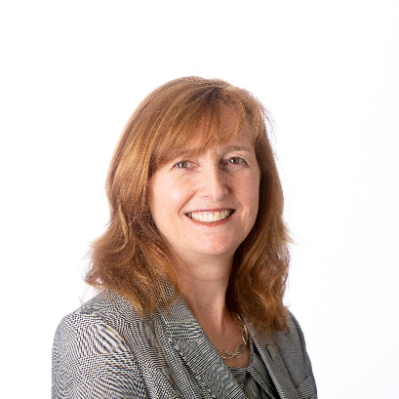
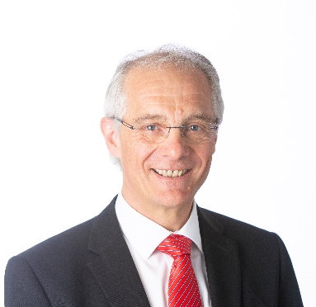
Introduction
We are delighted to present The Clatterbridge Cancer Centre’s (“CCCs”) summary strategic direction – setting out our key objectives and choices to ensure that we continue to deliver excellence for our patients.
This strategy builds on the excellent work developed by teams across the Trust – working together and with our partners – to shape a highly ambitious range of priorities which build on our strengths, and help us realise the opportunities and meet the key challenges which we will face within the changing NHS.
This strategy is presented in two phases. Its main focus is on our strategic priorities to 2022. These priorities are built around – but are certainly not limited to – delivering our new model of cancer care. This will have a fundamental impact on everything we do, allowing us to provide high-quality, sustainable services into the future, move care and treatment closer to our patients and their families, and bring together care with pioneering research.
Our other priority objectives and programmes – working across the system, being enterprising, investing in research and innovation, maintaining excellent quality, financial and operational performance and developing our people – are designed to complement and support this transformation. None of our ambitions for excellence – whether relating to care, research or supporting our staff, can be achieved in isolation from the others.
However, we will realise the full potential of these changes only by complementing them with longer-term plans. This strategy therefore includes initial thinking about how our priorities will evolve to 2027 and beyond. Our focus here will be on working across the system, building on our current strengths in order to play a leading role in the development of excellent, integrated cancer care and research across Cheshire and Merseyside and beyond.
This is intended as the start of a debate about how CCC and its partners should work together to meet the longer-term cancer challenge – and therefore to deliver the best possible outcomes for our patients and community. We would welcome contributions to develop our thinking.
Achieving the transformation set out in this strategy will make this the most exciting time in CCC’s history. We look forward to working with our staff, patients and partners to realise these changes and to continue our transformation further into the future.
Phil Edgington
Chair
Ann Farrar
Interim Chief Executive
Excellence in care, research and innovation

Slide 3
Contents
Executive Summary. |  | 3
About The Clatterbridge Cancer Centre |  | 4
The Challenge – local, national, and international |  | 5
Meeting the Challenge – our strategic priorities for 2018-22 |  | 7
Transforming Cancer Care: Our new clinical model. |  | 8
Collaborative system leadership. |  | 14
Investing in research and innovation. |  | 16
Developing our outstanding staff. |  | 19
Looking ahead - to 2027 and beyond |  | 21
Bringing it all together - what will our strategy mean for patients, staff and our partners? |  | 22
Implementation – delivering the change. |  | 23
APPENDIX A: Interdependencies between our strategic priorities |  | 26
APPENDIX B: New Clinical Model – Service availability and locations |  | 27
APPENDIX C: CCC Research – our national and international reach |  | 30
APPENDIX D: Linking our strategic priorities to Long-term Outcomes and benefits |  | 31
Excellence in care, research and innovation

Slide 4
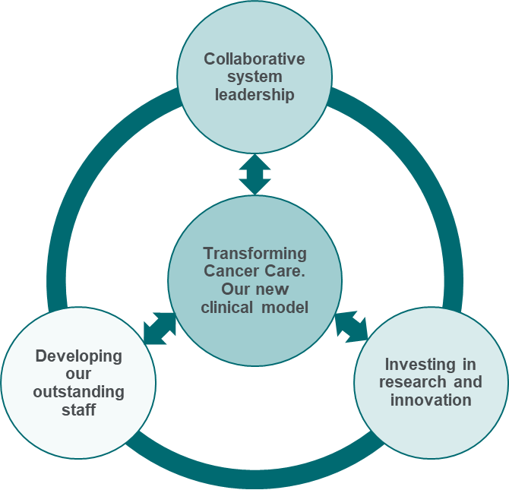
Executive Summary
Our Values
Putting people first
Achieving excellence
Passionate about what we do
Always improving our care
Looking to the future
The Clatterbridge Cancer Centre (“CCC”) is one of the UK's leading cancer centres, bringing together expert staff, high-quality care and excellence in research. This strategy sets out how we will take the care and research we provide to the next level by transforming our organisation over the next four years, as well as early thinking about our contribution across the system to 2027.
CCC provides outstanding care, and is investing in a significant transformation programme. However, the continued challenge of cancer outcomes across Cheshire and Merseyside (“C&M”), and indeed for England as a whole, means that we must strive for continued improvement. We must also ensure that we can harness – and indeed drive – the transformative potential of new treatments and research in one of the most innovative areas of medicine.
Our four major priorities (shown right) form a mutually-reinforcing programme to allow us to meet these challenges and realise our ambitions. Our two other supporting strategic priorities (making six in total) - being enterprising and maintaining our excellent quality, operational and financial performance, both deliver the stable cross-cutting platform necessary to drive transformational change.
Our new clinical model (p.8-13) will provide high-quality, sustainable care, meet significantly growing expectations and demand for treatment, integrate care and research, and maximise accessibility. Our four ‘hubs’ will provide the majority of care for common cancers, significantly increasing the range of treatment which is provided closer to patients’ homes. Our new hospital in Liverpool will physically integrate complex cancer care, acute oncology services, and research centres of excellence. Finally, all elements of our care will be underpinned with digital transformation through our ‘Connecting for the Future’ programme.
Playing a key role in system collaboration and implementation (p.14-15): We will only continue to deliver for our patients if we broaden our influence and leadership – both locally and more widely. We will play a leadership role in the C&M Cancer Alliance to lead the development of a ten-year plan for cancer across C&M (on behalf of our Cancer Alliance). This will be a systemwide plan taking in all aspects of the cancer pathway – from screening and prevention through to specialist care. We will also continue to work collaboratively across the system, nationally and internationally to advance excellence in both research and care. Investing in research and innovation (p.16-18): We will transform CCC into a ‘research active hospital.’ This will include doubling participation in clinical trials and the number of studies we sponsor, and ensuring we retain our Experimental Cancer Medicine Centre (“ECMC”) status. We will work with our research partners, in the Liverpool Knowledge Quarter any beyond, to advice cancer research across C&M, and to translate research from ‘bench to bedside.’ Complementing this, we will also maximise our opportunities to be at the forefront of innovation – including by adopting new clinical and digital technologies and applying innovative approaches to service delivery.
Developing our outstanding staff (p.19-20): Our organisational development strategy will support our people to focus on improvement and excellence – and to embed our values in everything they do.
We must also ensure a constant focus on the future. These four priorities are therefore complemented by early thinking about longer-term change – across a 10 year horizon (p.21). Finally, we bring our priorities together to show what they will mean for our patients, staff and partners, and how they will be implemented (p. 22-25).
Excellence in care, research and innovation

Slide 5
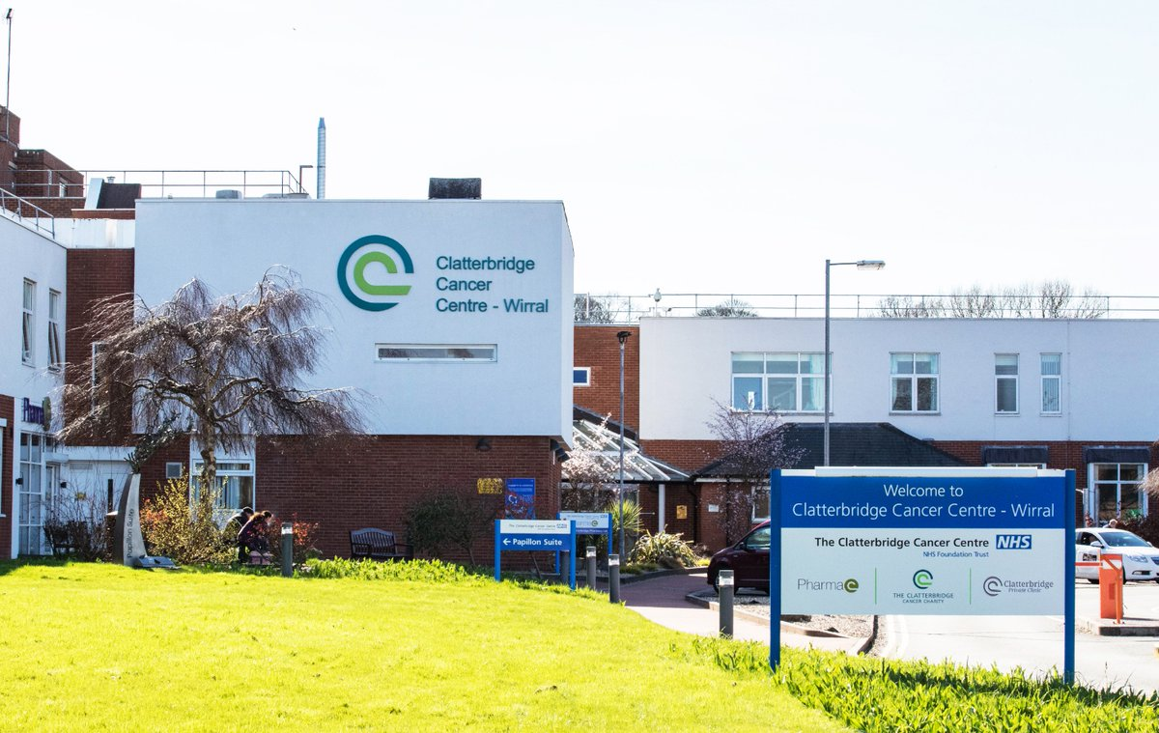
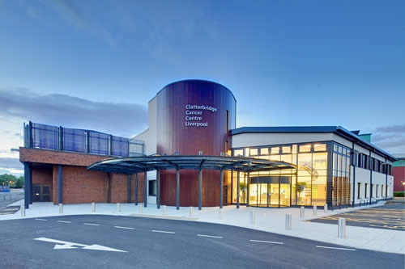
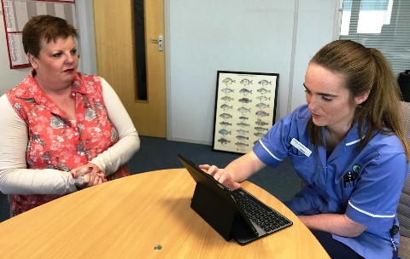
About the Clatterbridge Cancer Centre
About the Clatterbridge Cancer Centre:
The Clatterbridge Cancer Centre is one of the UK's leading cancer centres. We bring together expert staff, high-quality treatment and excellence in research to provide outstanding care and drive forward leading-edge drugs and therapies.
We provide specialist, non-surgical cancer care for solid tumours and blood cancers to a population of 2.4m people across Cheshire, Merseyside and the surrounding areas including the Isle of Man. We also provide highly specialist services on a national and international basis.
We are based in Wirral, supported by a radiotherapy treatment centre in Aintree, Liverpool. We also operate specialist chemotherapy clinics in seven of Merseyside’s district hospitals and deliver a pioneering Treatment at Home service, which has grown significantly in recent years. Together, this enables us to provide a comprehensive range of inpatient care, advanced radiotherapy, chemotherapy and other systemic anti-cancer therapies (i.e. medicines) including gene therapies and immunotherapies. From July 2017, we also began to provide regional specialist services for patients with blood cancers. We are also the only facility in the UK providing low-energy proton beam therapy to treat rare eye cancers and host the region’s Teenage and Young Adult Unit, (supported by the Teenage Cancer Trust).
More than 1,200 staff are employed at the Centre, with volunteers providing additional support and services. The Trust spends approximately £133m per year on all aspects of cancer treatment, diagnosis and care.
We work closely with our partners regionally, nationally and internationally. We host the Cheshire and Merseyside Cancer Alliance and are members of the Health and Care Partnership for Cheshire and Merseyside.
Organisational context for this strategy:
This strategy sets out how we will take the care and research we provide to the next level by transforming our organisation over the next four years, as well as early thinking about our contribution across the system to 2027.
Our level of ambition is built on a position of strength developed over many years:
The CQC rated us as Outstanding in their 2017 inspection.
To underpin transformation of our services, we have committed significant investment of £162m into the building of our new hospital in central Liverpool and the refurbishment our current hospital site.
We have committed significant investment (including £2.2m in 18/19) to support the delivery of common cancer care (Breast, Lung, Colorectal and Urological) closer to home, wherever safe and practical.
We have identified additional investment of £1.8m over 3 years in our cancer research to build on our reputation and retain Experimental Cancer Medicine Centre (ECMC) status in 2022.
Excellence in care, research and innovation

Slide 6
The Challenge – local, national, and international
The cancer challenge in Cheshire and Merseyside:
Each year nearly 18,000 people are diagnosed with cancer in Cheshire and Merseyside (“C&M”) and more than 8,000 die from the condition. Compared to England as a whole, that represents 1,100 excess cases and over 700 excess deaths per year. This is despite the fact that C&M has been at the forefront of significant public health initiatives, such as the pioneering Healthy Lung campaign, and also delivers cancer support and information services through partners such as Macmillan and Maggie’s.
Cancer incidence has risen across Cheshire and Merseyside at double the rate seen nationally. There are high levels of variation across the region (for example between Knowsley, Liverpool or Halton CCGs and Vale Royal CCG), meaning that cancer is a key population health challenge.
Over the same period, mortality rates from cancer have declined –reflecting a combination of improvements in prevention, earlier diagnosis and better treatment. However, relatively greater improvements in other areas mean that cancer still accounts for the highest proportion of deaths across the region each year. It is also a key contributor to health inequalities, accounting for 22-24% of the total difference in life expectancy between the most and least deprived areas (quintiles) nationally.
Reducing cancer mortality is a key population health priority across the region (as well as more widely).
Improving cancer outcomes – the local, national and global challenge:
As a leading specialist centre, we must aspire not only to provide excellent care in our region, but also to lead national efforts to improve cancer outcomes and to advance research and care.
Improving cancer outcomes has been a high-profile NHS priority for
some time. For example, the National Cancer Strategy sets ambitious goals for improving one-year and ten-year survival rates to 75% and 57% respectively. Current survival rates in C&M are 70% (1 year) and 49% (10 years).
It is certain that this high national profile and focus on cancer will continue into the future. The National Cancer Strategy expires in 2020, and will likely be succeeded by a further level of ambition. One of five priorities for the national 10 year plan for the NHS, which is currently in development, will be “transforming cancer care so that patient outcomes move towards the very best in Europe.” This is not the case at the moment (see box overleaf).
Excellence in care, research and innovation

Slide 7
The Challenge – local, national, and international
The challenge and opportunity of research and innovation:
The imperative to improve outcomes arises partly from the sheer potential of breakthroughs in research and innovative treatments.
Cancer care is one of the most innovative areas of medicine, and the next few years could see the realisation of whole new fields of treatment. Genomic medicine and immunotherapies will realise the potential of personalised medicine for cancer patients, and artificial intelligence is already developing breakthroughs in cancer diagnosis (for example in detecting cancerous tumours).
The fact that cancer care is such an innovative and fast-moving area means that it will be increasingly important for providers to focus on – and build their capability in relation to - both care/treatment and research and innovation. To do otherwise risks clinical teams being disconnected from innovations which could further improve the care they provide and the associated patient outcomes.
The NHS provider challenge:
In addition to the future cancer challenge – both locally and more widely – we must of course operate within an increasingly challenging NHS context.
All NHS providers are expected to both find efficiencies year on year, and to contribute to the transformation of services – working across their local health and care economies – in order to make them fit for the future. They must do this while continuing to meet challenging performance standards, as well as wider patient and public expectations about the quality, timelines and experience of care.
Implications for CCC:
Responding to more people living longer with cancer provides a number of implications for CCC, including that:
We must continue to focus on providing an outstanding, caring, and patient-focussed service to our population, as well as on improving efficiency and maintaining excellent operational performance. All other ambitions must be built on this solid foundation.
Improving cancer outcomes will require us to work with others across C&M, to integrate care and to promote prevention and early diagnosis. We must work together to continue to close the outcomes gap with other areas of the country.
As part of this system wide integration, we must consider how we can provide more of our services closer to – or in – patients’ homes, as well as continually improving our patients’ and their families experience of care.
We must ensure that CCC is an excellent place to work. We will only realise our ambitions if we can attract, retain and develop the best people – as well as meeting the future workforce challenges which all NHS providers will face.
We must support our clinicians to continue to work at the forefront of care and treatment, bringing innovation from ‘bench to bedside.’
The following sections set out our strategic priorities for responding to this challenge to 2022, as well as early thinking about longer-term change.
“Four types of cancer are among the 12 top causes of death in wealthy countries: lung, colorectal, breast and pancreatic. Survival rates […] are a widely recognised measure for comparing the quality of cancer care.
Judged on this basis the UK is below average for people with all these types of cancer – although we are gradually closing the gap. For lung, colon, and pancreatic cancer, the UK does especially poorly. Among the cohort of comparison countries, we are the worst for pancreatic and colon cancer and the second-worst for lung cancer.”
The Health Foundation, Institute for Fiscal Studies, The King’s Fund and the Nuffield Trust, 2018: The NHS at 70 – How Good is the NHS?
Excellence in care, research and innovation

Slide 8
Meeting the Challenge – our strategic priorities for 2018-22
Our strategy for 2018-22 focusses on four major priorities, delivered via being enterprising and also maintaining excellent quality, financial, and operational performance. Taken together, they represent a major investment - transforming both the care we provide to our patients, and our leadership role in treatment and research.
Our four major priorities (shown right) form a mutually-reinforcing programme of action to allow us to realise our vision. These are deliverable within an overall environment of maintaining our excellent quality, operational and financial performance, which also encourages us to be enterprising (our two supporting priorities).
Responding to more people living longer with cancer: Our new clinical model
A new model of care: Local where possible, centralised where necessary, and based around delivering equitable access to high quality care and research.
A new flagship hospital in Liverpool, integrating acute oncology services and research centres of excellence.
The next phase of integration of non-surgical oncology (haemato-oncology services) across the region.
Complete digital transformation through our ‘connecting for the future’ programme.
Collaborative System Leadership:
Lead the development of a systemwide ten-year strategy and implementation plan for cancer across C&M.
Continue to contribute to - and lead - locally and nationally in key areas of care and research, including through embedding our new clinical model.
Support the development of a radiotherapy network with Greater Manchester and South Lancashire, covering a population of over 6 million people.
Play a significant role in the design of leading-edge integrated care and research models across Cheshire and Merseyside.
Investing in research and innovation:
Double participation in clinical trials, double the number of CCC-sponsored studies, and become renowned for qualitative research.
Ensure continued access to cutting-edge research through ECMC status.
Lead the research and innovation agenda through taking an active leadership role in Liverpool Health Partners, the Liverpool Knowledge Quarter, the North West Coast Innovation Agency and the Clinical Research Network (“CRN”).
Maximise our opportunities to be at the forefront of innovation.
Developing our outstanding staff:
Embedding our values in everything we do.
A consistent approach to quality improvement.
Developing a comprehensive approach to Education and Training
A focus on engaging and empowering staff.
Leadership development and succession planning to meet our workforce challenges.
A brief analysis of how the key actions within each priority reinforce each other is enclosed at Appendix A.
Excellence in care, research and innovation

Slide 9
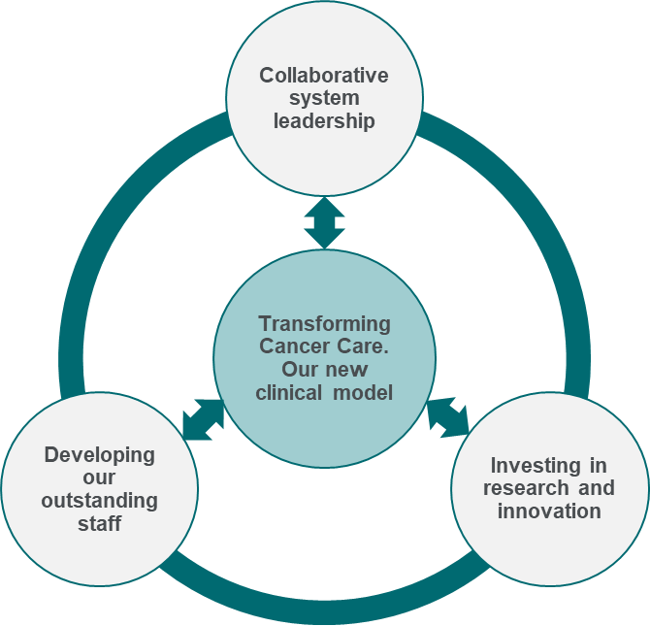
Transforming Cancer Care: Our new clinical model
Our new clinical model will deliver high quality, equitable and sustainable cancer care services, provided around the needs of the patient.
Responding to more people living longer with cancer: Our new clinical model
A new model of care: Local where possible, centralised where necessary, and based around delivering equitable access to high quality care and research.
A new flagship hospital in Liverpool, integrating acute oncology services and research centres of excellence.
The next phase of integration of non-surgical oncology (haemato-oncology services) across the region.
Complete digital transformation through our ‘connecting for the future’ programme.
Transforming Cancer Care (“TCC”) is a comprehensive programme of change to allow us to meet the challenges we face in providing high-quality, sustainable care into the future. This includes meeting significantly increased demand for key treatments, and allowing us to integrate care and research and to maximise accessibility.
Our New Clinical Model:
The heart of this approach is our networked delivery model operating across Cheshire, Merseyside and the Isle of Man. This allows us to plan, coordinate and deliver complex services centrally whilst also bringing less complex care closer to patient’s homes. Movement of patient care services will be subject to appropriate consultation.
The model ensures that we can deliver high quality, equitable, and sustainable care as locally as possible, whilst also integrating care and research and introducing innovation more quickly:
Local hospitals or community, home or work-based provision will provide follow-up care for non-complex cancers, meaning that the majority of our patients will access this care either close to – or at – home, work or community settings. All local hospitals will also have on-site acute oncology services linked to 24/7 expert advice and a range of options for joined up ambulatory care.
Four Clatterbridge Sector Hubs will provide the majority of first Clatterbridge appointments for common (and some intermediate) cancers. They will provide more complex chemotherapy, as well as a co-located, dedicated ambulatory acute oncology service. Three of the hubs will also provide radiotherapy.
Moving to four ‘sector’ hubs around the region will allow us to provide the optimum balance between local care for our patients, and ensuring that all patients can consistently see a tumour-site-specific consultant-led team of experts for their first appointment. This team will co-ordinate all aspects of their care and treatment (see page 10). Sector Hubs will provide extended hours services,7 days a week.
The Centre at the new CCC Liverpool will provide inpatient facilities, and support the most complex and experimental treatment. It will also centralise expertise for rare and intermediate cancers (see next page).
Our sector hubs will be based at CCC@Wirral (A) (current CCC site, which will be re-furbished), CCC@Aintree (B), CCC@Liverpool (C) (which also hosts The Centre), and CCC East (D) (location TBC through public consultation).
Excellence in care, research and innovation
*Including skin, upper GI, hepatobiliary and pancreatic, gynaecology, head and neck, teenage and young adult, most sarcomas, and brain and central nervous system cancers.

Slide 10
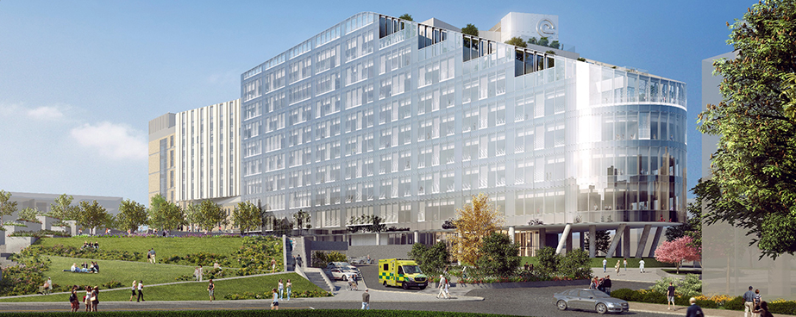
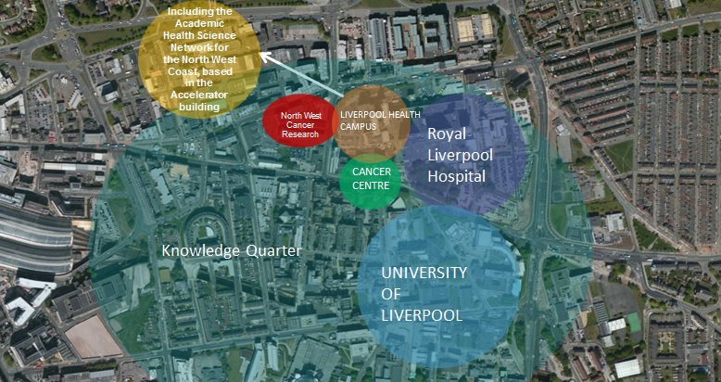
Transforming Cancer Care: Our new clinical model
Our new clinical model will deliver high quality, equitable and sustainable cancer care services, provided around the needs of the patient.
A new flagship hospital:
TCC is built around the new CCC Liverpool. It will provide inpatient facilities, supporting the most complex and experimental treatments, as well as centralising expertise for rare and intermediate cancers.* This new centre will provide significant benefits for patients, their families, staff and our partners, including:
Increasing access: CCC Liverpool will be located near the centre of our patient population, and has greatly improved transport links. Around 63% of our patient population lives nearer to CCC Liverpool than our current Wirral site. This includes some of our most disadvantaged patients, who are least able to travel.
Quality benefits through co-location: Co-location with acute hospital services will allow CCC patients swift access to medical and surgical sub-specialities where required. We will also deliver better access to intensive care for our sickest patients. This will be increasingly important as we continue to develop and deliver new, innovative treatments. We will also work with the Royal Liverpool Hospital to systematically improve how we work together, so that patients benefit from as ‘joined up’ a cancer pathway as possible.
A single service for haemato-oncology: CCC Liverpool will bring together care of people with blood cancer with care for solid tumours.
Creating an environment for research and innovation to flourish:
CCC Liverpool is situated at the heart of the ‘Liverpool Knowledge Quarter.’ This is home to some of the world’s most influential players in science, health, technology, culture and education. It aims to position Liverpool at the forefront of global innovation, bringing together key partners to collaborate in a creative environment and closing the economic gap with London and the South East.
CCC has a key role to play in achieving this vision. Our new hospital will be co-located with key academic, NHS and research partners (see below). It will act as an ‘incubator’ for innovation, informal research and collaborations, as well as formal research studies. Access to on-site critical care will allow us to undertake Phase I and ‘first in human’ research, and CCC Liverpool will host a permanent clinical trials team.
Co-location in the Knowledge Quarter will also allow cross-fertilisation across sectors, allowing CCC innovators to both contribute to, and learn from, leading developments outside healthcare.
Excellence in care, research and innovation
*Including skin, upper GI, hepatobiliary and pancreatic, gynaecology, head and neck, teenage and young adult, most sarcomas, and brain and central nervous system cancers.

Slide 11
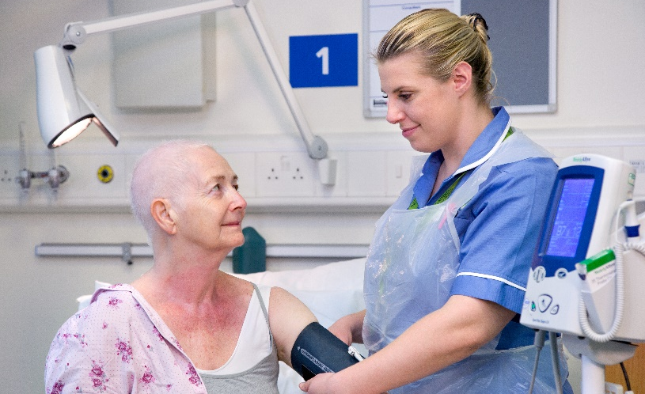
Transforming Cancer Care: Our new clinical model
Our new clinical model will deliver high quality, equitable and sustainable cancer care services, provided around the needs of the patient.
Our new clinical model will further improve key aspects of our outstanding care. These changes respond to the needs of our patients and partners across the region. Importantly, they will ensure we can meet the significantly increased demand for key treatments which we expect in future years, whilst maintaining access and service quality.
The transformed CCC Cancer Care Pathway:
Consistent quality and improved reliability: Assessment by MDT specialists.
Team based service with improved convenience: Offering increased clinic availability extended days and hours of the day, 52 weeks p.a. including supportive care,
More patient-focussed, co-ordinated care: CCC team responsible for co-ordinating drug and radiotherapy treatments, including linking with GPs and surgical teams with use of digital technology.
More local care through innovation: Most treatments and follow-up provided in CCC hubs, local hospitals, or through our pioneering CCC@home and CCC@work services.
Diagnosis of cancer and agreed referral to CCC
Patient-centred needs: assessment in 1 of 4 specialist CCC sector hubs in the region
CCC-led, co-ordinated treatment as close to home as possible
Follow up as close to home as appropriate
Improved access: First CCC appointment within seven days through team based service.
Improved access to research: Routine screening for entry into clinical research trials.
Improved links to urgent care: 24/7 acute oncology support, linked to MDT.
Improved links to palliative care where required: Palliative care is an integral part of the clinical model.

Slide 12
Transforming Cancer Care: Our new clinical model
Our new clinical model will deliver high quality, equitable and sustainable cancer care services, provided around the needs of the patient.
The challenge…
How our new clinical model will meet the challenge…
The current model of single-handed consultant practice is neither sustainable or optimal. For example, we currently cancel a number of clinics due to lack of consultant availability.
All patients will have their care managed by a multi-disciplinary team, rather than a single consultant. This will provide consistent care across all sites.
Team-based working is more resilient, operating extended working hours.
Team working also provides much greater opportunities for staff development.
Patients and their families sometimes face long travel times and distances for care.
Our model provide services as close to patients homes as possible. 93% of patients live within 45 minutes of their nearest sector hub.
63% of our population lives nearer to CCC Liverpool than our current Wirral site, which will also be significantly more accessible by public transport.
Not all patients have access to comprehensive supportive care services at their first appointment.
All patients will be offered a ‘holistic needs assessment’ as part of their first appointment.
Sector hubs will be integrated with local medical, surgical and support services, ensuring a single approach to care for all patients from the outset.
Too many patients do not have access to a clinical trial.
Patients will be automatically screened to entry into clinical research as part of their holistic assessment.
Located in the new Liverpool ‘Knowledge Quarter,’ CCC Liverpool provides an ideal environment for integrating research and care.
Growing demand within constrained resources. CCC has to see all new patients on 62 day pathway within 7 days. This is critical to 62 day performance across C&M.
Our plan secures the required operating capacity to deliver access targets (62 day and 18 weeks) and accommodate growth in demand for our services.
All first appointments will be provided within 7 days, and treatment within 24 days.
A new model of acute oncology services can help to reduce A&E attendances and unplanned admissions.
All Clatterbridge sector hubs and local hospitals will have greater access to a range of urgent care services as an alternative to A&E.
A 24/7 hotline will offer expert cancer advice, linked to treatment centres, paramedic and acute oncology services.
Excellence in care, research and innovation

Slide 13
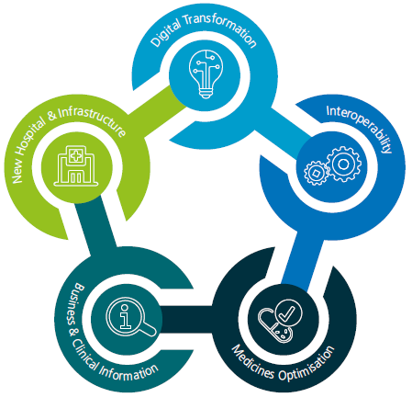
Transforming Cancer Care: Our new clinical model
Our new clinical model will be underpinned by our ‘Connecting for the Future’ programme for digital transformation - across CCC and more widely.
‘Connecting for the future’ is CCC’s Global Digital Exemplar (GDE) Programme for transforming cancer care through the use of world-class digital technology. It will ensure that digital transformation underpins every aspect of our new clinical model.
As part of the Connecting for the future programme, we will be developing and implementing a suite of digital tools, with the aim of creating agile clinicians and digital patients who have been empowered through technology and innovation.
The agile clinician:
Our clinicians rely on having fast and efficient access to the information they need to make the best decisions for our patients. To enable this to happen, we will:
Connect and develop our computer systems to ensure that clinically relevant information is accessible where and when needed, supporting safe and effective care while reducing duplication.
Introduce electronic prescribing, reducing the risk of medication error and improving the efficiency of the dispensing process.
Provide our clinicians with access to secure digital messaging and meeting services to improve communication.
Introduce a quick and secure ‘tap on and tap off’ process for signing in to computer systems, enabling convenient access to patient information and fast user switching.
Send clinical documents and discharge notes to our Merseyside GP practices electronically and securely, so that patient records can be updated automatically, improving care continuity and removing paper from the process.
Introduce speech recognition that will work with our computer systems. This will allow clinicians to capture and document patient details quickly and accurately, saving time and speeding up information availability and quality.
Continue to support the development of a regional clinical portal, which will provide clinicians with access to a complete patient record into which all care organisations can provide input.
Our approach to Transforming Cancer Care through the use of world-class digital health technology and information is supported by five digital themes
Excellence in care, research and innovation

Slide 14
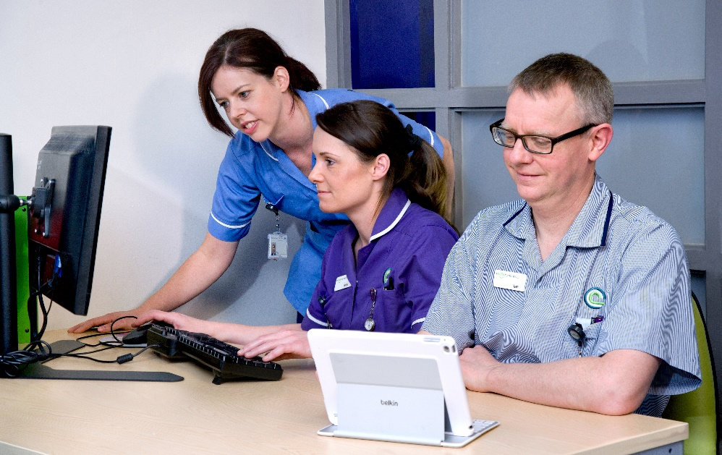
Transforming Cancer Care: Our new clinical model
Our new clinical model will be underpinned by our ‘Connecting for the Future’ programme for digital transformation - across CCC and more widely.
The digital patient:
To improve the health and wellbeing of our patients, we need to make it easy for them to manage their condition, connect with services and access help and guidance from wherever they are. To enable this to happen, we will:
Launch an online patient portal, providing access to medical records, appointment details and guidance on accessing support and advice.
Develop useful mobile phone apps, which will help our patients understand and manage their condition.
Introduce kiosks that will enable our patients to check in for their appointments quickly and securely, whilst also providing an opportunity to review and update their contact preferences.
Introduce a telehealth service, which will enable our clinicians to monitor data on certain aspects of a patient’s health remotely, without the patient having to attend the clinic in person.
Improve the experience and support the health and wellbeing of our patients through better digital signage, education and entertainment services whilst in hospital.
Leading digital developments across the system: Digit@LL:
Digit@LL is the digital strategy for C&M to 2023. The objectives of the programme are to:
Engage patients/citizens: Actively engage and co-produce with those we are here to service.
Empower: Deliver a set of digital health tools for citizens and staff.
Enhance: Support all Places to have integrated systems meeting a minimum level of digital maturity with brilliant basics everywhere.
Connect: Deliver a connected information exchange with a single Information Governance framework.
Innovate: Fully exploit the data and intelligence available across C&M to maximise the effectiveness of our services.
Secure: Support all organisations to deliver robustly managed Cyber Security services.
As part of the programme, we will:
Empower individuals to care for themselves and take control of their health and wellbeing.
Empower staff to have access to high quality information and the digital resources they need to deliver safe, high quality, efficient care.
Achieve a joined-up, efficient and informed patient journey, based on secure, real-time patient data; and
Make C&M the area innovators want to come to for digital excellence.
Excellence in care, research and innovation

Slide 15
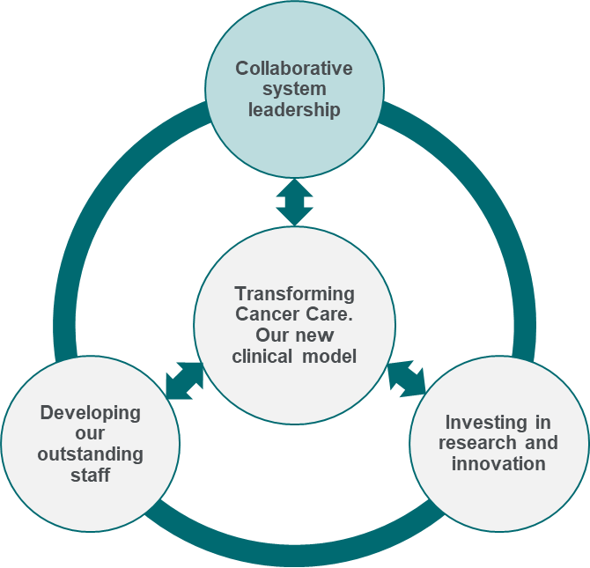
Collaborative system leadership
Our new clinical model provides an excellent platform for working across the health and care system. Over the next three years we will focus increasingly on collaborative and systemwide working.
Collaborative System Leadership:
Leadership role in the development of a systemwide ten-year strategy and implementation plan for cancer across C&M.
Continue to contribute to - and lead - locally and nationally in key areas of care and research, including through embedding our new clinical model.
Play a significant role in the design of a radiotherapy network with Greater Manchester and South Lancashire, covering a population of over 6 million people.
Play a significant role in the design of leading-edge integrated care and research models across Cheshire and Merseyside.
Our system values our clinical expertise in providing outstanding non-surgical cancer care. However, we will only continue to deliver for our patients if we broaden our influence across the whole cancer pathway in future, working closely with all of our partners. We will therefore play an increasing role across C&M, and more widely, over future years, focussed on delivering the benefits of closer system integration.
System leadership across C&M:
The C&M Cancer Alliance (reporting to the Cheshire and Merseyside Health and Care Partnership) affords CCC an invaluable opportunity to work with all partners to shape the system leadership agenda. The early progress made by the Alliance with its transformation priorities, alongside its trailblazer status for delivery, mean that it is an ideal partner and delivery vehicle to help CCC shape the future of cancer care for the benefit of patients in C&M.
CCC has the support of the Alliance to be an active leader in the development of a ten-year plan for cancer across C&M. This will be a systemwide plan taking in all aspects of the cancer pathway – from screening and prevention through to specialist care.
We will also work through the Alliance to deliver a successful bid for years three and four of the National Cancer Transformation Fund, and to improve access to clinical trials for C&M.
We will also continue to lead and contribute to systemwide work in key areas of care and research, for example:
Leadership for palliative care: We are working with partners to empower people to live well before dying through the C&M Programme Board for Palliative and End of Life care. The board will ensure that our care provides personalisation and choice at the end of life, integrates services, provides as much care as possible out of hospital, and continuously improves patient experience.
Leadership for specialist cancer nursing: CCC plays an active role in the Lead Cancer Nurses Clinical Quality Group - an expert forum for promoting clinical excellence and developing policy for cancer nursing. It provides expert advice to a wide range of healthcare professionals across the region, as well as developing the nursing-specific elements of the Cancer Alliance work programme.
Digitising care across the system: We are working with partners to implement Digit@LL – the C&M digital strategy (see page 13).
Partnerships with Universities: We will focus on leadership for research and education on a greater scale and impact across C&M, to be done in a strategic partnership with our University partners to support economic re-generation. This will allow us to play a key role in improving health outcomes for the region and develop a national and international profile as leaders in cancer care.
Excellence in care, research and innovation

Slide 16
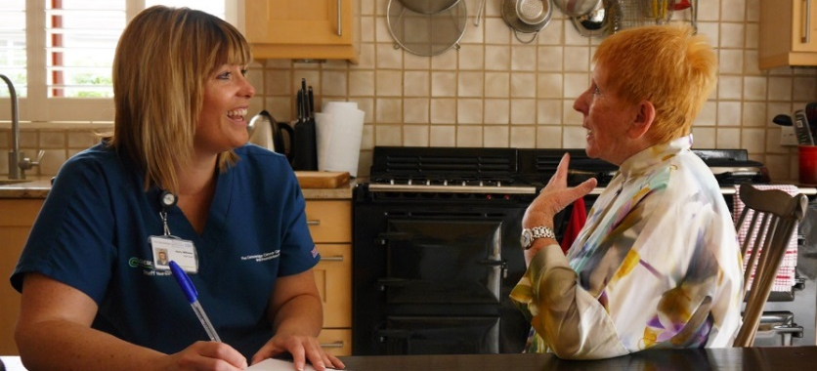
Collaborative system leadership
Our new clinical model provides an excellent platform for working across the health and care system. Over the next three years we will focus increasingly on collaborative and systemwide working.
Regional leadership:
We will work with commissioners and our provider partners to develop proposals for chemotherapy and radiotherapy clinical networks at regional level. Creating common systems and protocols for care and management will provide an opportunity for CCC to share its outstanding practice, and to learn from them in return, and therefore increase consistency of use of standards and reduce unwarranted variation in care. For example, CCC are already leading the way nationally in the development of ‘at home’ chemotherapy services, in co-ordinating chemotherapy across multiple sites, and in introducing innovative treatments – all of which could benefit patients more widely.
We will explore a network alliance for radiology with the Royal Liverpool Hospital and Aintree Hospital (subject to proposed merger) and other Trusts. This will help us to lead efforts to drive quality and consistency in radiology reporting, tackling an identified system wide need.
National leadership – building on our strengths:
CCC clinicians are acknowledged national leaders in areas including breast, lung and pancreatic cancer, and haemato-oncology. Our research and innovation strategy (see page 16) sets out how we will build on these over the next four years, as well as extending our focus to qualitative research. In addition, our clinicians will continue to shape the national agenda for cancer care and treatment through membership of national reference panels (influencing new clinical guidance), and through bridging the gap between research and clinical practice.
Our new model of care will be a national exemplar in cancer treatment. For example:
It will underpin a single common infrastructure for the management of chemotherapy and radiotherapy services across the entirety of C&M.
It will provide a nationally-leading service for chemotherapy closer to home (Clatterbridge in the Community). This service is already growing rapidly, and is expected to provide over 2,500 treatments per year by the end of 2018; and
Our new hospital will have fully integrated acute care on the same site – the only standalone cancer centre with this in England.
Page 18 sets out how our focus on innovation will support this continued national leadership in care.
System integration beyond cancer services:
Health and care economies across the country are currently considering how their models of care need to change in order to integrate services around patients and populations, and therefore how organisational, governance and assurance models need to change to support them. These changes have the potential to unlock major benefits for patients and citizens.
CCC will make an increasing contribution to systemwide change. We will play a full and leading role in developing the integration agenda across C&M, including as members of the Health and Care Partnership for C&M. We will also continue our collaboration and benchmarking work with the Federation of Specialist Hospitals.
CCC are leading the way nationally in development of chemotherapy in patients’ homes.
Excellence in care, research and innovation

Slide 17
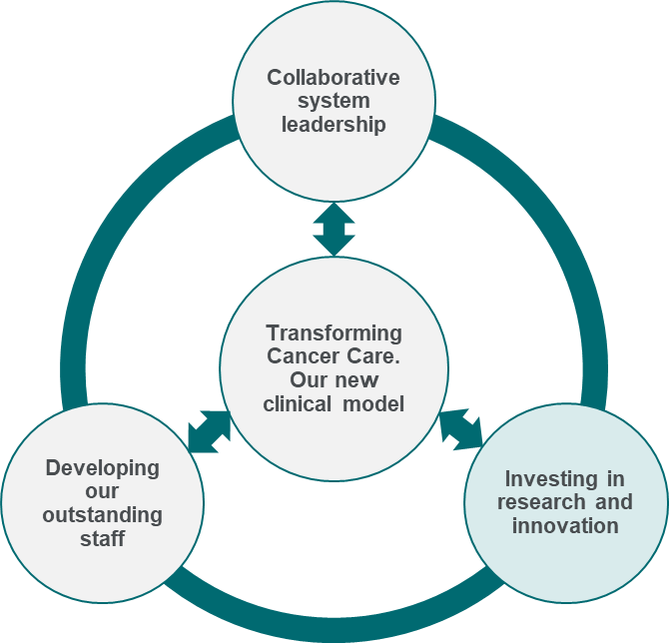
Investing in research and innovation
We will build on CCC’s pioneering research developments in order to raise our research profile nationally and transform CCC into a ‘research active hospital.’
We will build on CCC’s pioneering research in order to raise our profile nationally and internationally, and transform CCC into a ‘research active hospital.’ Our research strategy will bring research into practice and so help us realise our vision of ‘excellent research for patient benefit.’
Our new clinical model will fully integrate clinical research teams into the multi-disciplinary team working concept. We will consolidate our existing research strengths into an internationally-recognised understanding of what characterises an outstanding patient experience. Elements of this consolidation include:
Our new site will provide an environment for research to flourish – including enabling closer working with key partners.
Patients will enter CCC through local hospitals and Sector Hubs. Therefore we will ensure equitable access to research wherever the patient is.
Our new IM&T infrastructure will facilitate screening of patient eligibility for research given all patients are potential participants.
Doubling participation in clinical trials:
Trial participation gives patients access to novel treatments and care approaches which are not available elsewhere, and they in turn contribute to others’ future care through their research participation.
We will increase participant recruitment from 526 to 1000 participants per year by 2020. We will do this through:
Smarter working, including using our new digital platform to proactively identify patients who could participate in trials..
Critical selection of studies including a particular drive to recruit to observational studies (see below); and
Promoting our biobank. The CCC Biobank gives our patients and their families’ opportunities to take part in broader research projects translating research from ‘bench to bedside.’
Becoming renowned leaders in qualitative research:
We will expand our presence in qualitative research (from 11% to 20% of our portfolio). This will reflect CCC’s caring and compassionate strengths, and will enhance the knowledge base which underpins our holistic approach to care. This will be supplemented by a Patient Panel for Research, including lay advocacy for the design and delivery of trials.
Double the number of studies for which CCC acts as sponsor:
We have invested heavily in academic oncology in recent years. We will now go further, doubling the number of studies for which we act as sponsor. This will bring a number of benefits including:
Raising the profile of CCC as a national opinion leader for research.
Making CCC an exciting and attractive Trust for talented research- focused clinicians, and providing a clear research development pathway for our ‘home-grown’ research and clinical fellows.
Bringing forward academic collaborations for a ‘bench to bedside’ approach, ensuring that our research is of direct benefit to patients.
Diversifying research sponsorships and income.
Investing in research and innovation:
Double participation in clinical trials, double the number of CCC-sponsored studies, and become renowned for qualitative research.
Ensure continued access to cutting-edge research through ECMC status.
Lead the research and innovation agenda through taking an active leadership role in Liverpool Health Partners, the Liverpool Knowledge Quarter, the North West Coast Innovation Agency and the Clinical Research Network (“CRN”).
Maximise our opportunities to be at the forefront of innovation.
Excellence in care, research and innovation

Slide 18
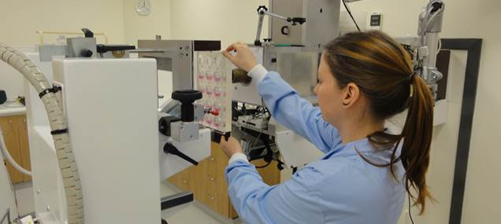
Investing in research and innovation
We will build on CCC’s pioneering research developments in order to raise our research profile nationally and transform CCC into a ‘research active hospital.’
Developing a ‘research active workforce’
By 2022 we will have 80% of our consultants enabling recruitment into research (up from 50% currently). We will do this through:
A review of Consultant job plans and investing in Consultant time specifically allocated to research.
Developing the next generation of researchers through our Clinical Fellows programme.
Expanding our recently-developed ‘research focused clinics.’
Continued participation in national programmes and regional partnerships to promote research posts and expertise.
Ensuring continued access to cutting-edge research and treatments through ECMC status:
The Experimental Cancer Medicine Centre Network (“ECMC”) is a collaboration of world-leading scientists and clinicians who bring together expertise and techniques to drive the discovery, development and testing of new cancer treatments and biomarkers in early phase studies and trials. CCC is the current NHS partner for the Liverpool ECMC.
ECMC status brings national and international recognition for our research, as well as access to novel therapies, drug developments, trials and partnerships otherwise unavailable to our researchers and patients. We will prioritise maintaining ECMC status when it is renewed in 2022.
Complementing this, we will also nurture and expand our strategic relationships with Pharma, enabling access to novel agents, funding for investigator-led and commercially-funded studies for which CCC is a participating site - generating investment income.
Leading research and innovation across C&M, nationally and internationally:
In addition to research excellence within CCC, our research strategy provides a platform for collaboration and research more widely, and therefore to realise benefits for our patients and the local economy, we will:
Work with Liverpool Health Partners to maximise the benefit of their Joint Research Office (JRO) infrastructure – bringing together academic and clinical partners for research and clinical trial design and delivery.
Work with the North West Coast Clinical Research Network to promote all types of cancer research across C&M, with the aim of reaching the top 20% of research areas for participant numbers nationally by 2022.
Work with the Innovation Agency (the Academic Health Science Network for the North West Coast) to support the adoption – and where applicable commercialisation - of our research into practice. This includes the adoption of proven innovation in relevant medical devices, digital technologies and innovative treatments in the Trust.
Work with partners to support the development of personalised medicine in line with the next stages of the 100K genome project.
The national and international reach of CCC’s research portfolio is outlined at Appendix C.
Excellence in care, research and innovation

Slide 19
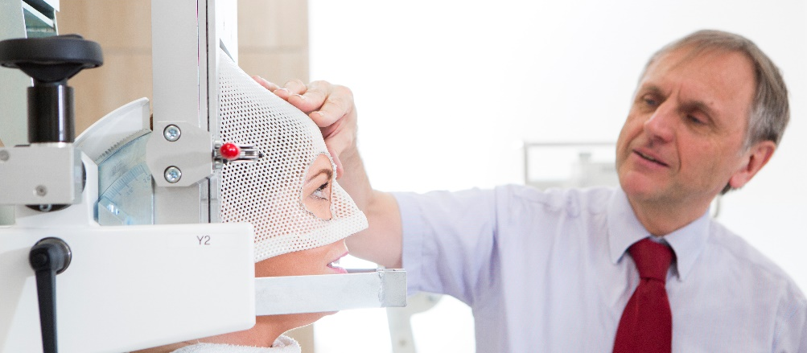
Investing in research and innovation
We will maximise our opportunities as a specialist trust to be at the forefront of innovation. We will adopt new clinical and digital technologies to transform care and apply innovative approaches to service delivery.
Maximising our opportunities to be at the forefront of innovation:
CCC has a strong tradition of innovation and is recognised nationally in a number of areas for ‘national firsts’ – including developing proton therapy for eye cancers (right) and Papillon treatment for rectal cancers.
We will continue to lead the way in innovation which bridges research and clinical care. For example, immunotherapy is one of the most promising treatments in the last decade. It represents a paradigm shift offering significant benefits in cancers previously responding poorly to standard chemotherapy treatments. At CCC we are proud to be at the forefront nationally in leading service innovation for delivery of immunotherapy treatments and management of side effects ensuring our patients have access to outstanding care.
We will further develop this innovation culture that allows novel approaches to flourish.
Building innovation into everything we do:
Innovation is no less important for our corporate and support services than for our clinical teams, all of whom will need to innovate and work differently in future. Our innovation priorities will enable us to become an organisation in which all of our teams feel supported to innovate, in relation to all aspects of the service they provide. We will:
Develop and implement new diagnostic and treatment technologies and drugs so that patients in Cheshire and Merseyside have early access to advancements in care.
Use the learning from our new clinical model to influence the local, regional and national development of new service delivery models (for example in ambulatory acute oncology care and immunotherapies).
Employ digital technologies to maximise the delivery of care closer to home using telemedicine.
Ensure our patients have access to their care records online.
Empower and enable patients to co-ordinate their care and communicate with CCC using latest digital technologies.
Transform our workforce through leading the way on novel role development in specialist cancer care, maximising the potential of our clinical and non-clinical staff. For example, we are actively developing new roles including physician associates, non-medical prescribers, care navigators, allied health professionals and clinical nurse specialists.
Build on our track record of commercial innovation, through maximising the potential of our subsidiary companies (PharmaC and PropCare) and Joint Venture (Clatterbridge Private Clinic), as well as seeking new commercial ventures and partnerships linked to our investment in research (see above).
Equip our workforce with improvement skills and techniques through a consistent approach to Quality Improvement (see page 19).
Excellence in care, research and innovation

Slide 20
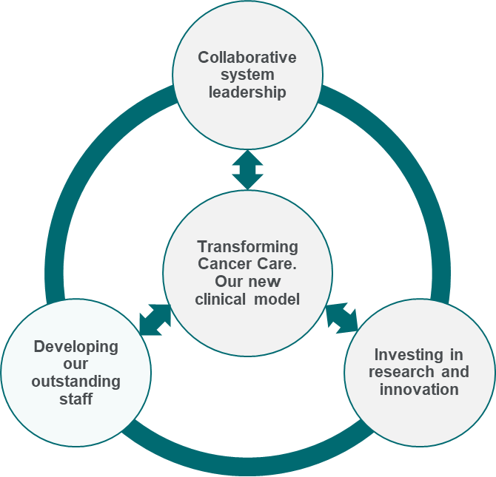
Developing our outstanding staff
We will support our people to focus on improvement and excellence in everything they do.
CCC’s successes and its current strengths are down to its outstanding people. However, we know that remaining an outstanding organisation will require a constant focus on improving our services and on developing our people. This will be all the more important as we support staff through the major changes to ways working associated with our new clinical model.
Our organisational development strategy will therefore support our people to focus on improvement and excellence in everything they do.
Embedding our values in everything we do:
This strategy is grounded in and fully aligned to our values. Our Board and senior leaders are fully committed to ensuring that our values remain front and centre as it is implemented. Our Council of Governors, new staff leaders forum, and staff and patient feedback will hold us to account for this as implementation proceeds.
We will also take a number of specific actions to further embed our values in everything we do. We will:
Promote our values through our new clinical model, including embedding multi-disciplinary team working and supporting clinical teams to develop a culture of shared responsibility and learning.
Embed values-based recruitment, appraisal, reward and recognition for all staff.
Ensure that Directorate priorities and staff objectives are explicitly linked to Trust values.
Promote ‘Freedom to Speak Up’ (the national integrated whistleblowing policy to standardise the way NHS organisations support staff who raise concerns).
Continuing to embed a culture of quality:
We will support people from ‘Floor to Board’ to strengthen their focus on enhanced quality. We will strengthen Directorate performance management through consistent dashboards and templates, underpinned by improved data quality and timeliness through our investment in data infrastructure.
Consistent reporting will then form the basis of a trust-wide focus on transparency which will include embedding the principles of good governance throughout the organisation, training staff in risk reporting and escalation, including specific consideration of risk appetite at Board level, and embedding a consistent approach to learning from mistakes. This will include robust mechanisms to ensure learning is spread across the organisation –including between sites as our new clinical model is implemented.
A consistent approach to quality improvement (QI):
However, embedding a culture of quality, transparency and excellence is not just about managing risk and performance. It is also about challenging ourselves to continuously improve the service we provide to our patients. Building on the CCC approach to change management, we will adopt a consistent methodology for QI. We will then work with the Advancing Quality Alliance (AQuA) to support rollout across the organisation – enabling staff to design and implement improvements in their areas.
Developing our outstanding staff:
Embedding our values in everything we do.
Continuing to embed a culture of quality, transparency, and excellence.
A consistent approach to quality improvement.
Developing a comprehensive approach to Education and Training.
A focus on engaging and empowering staff.
Leadership development and succession planning to meet our workforce challenges.
Excellence in care, research and innovation

Slide 21
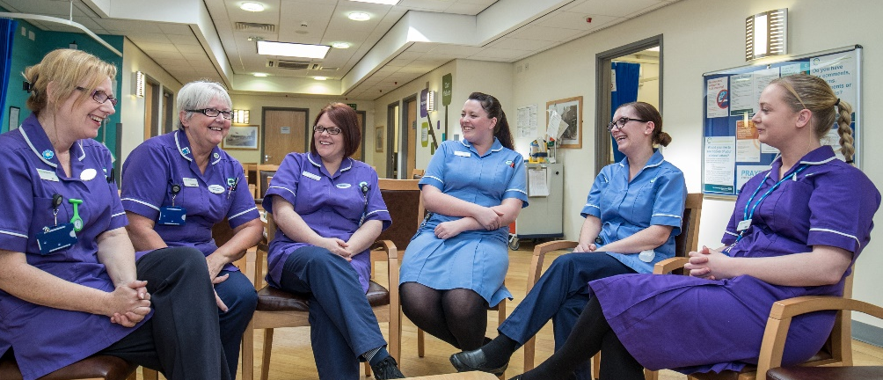
Developing our outstanding staff
We will support our people to focus on improvement and excellence in everything they do.
A consistent approach to quality improvement (continued):
Our QI approach will be underpinned by explicit permission from the Board for teams to work together on changes for patient benefit, supported by technology enabling real time reporting of innovation and best practice. A consistent QI approach will be particularly important in implementing the ‘team working’ elements of our new clinical model –giving multi-disciplinary teams a common framework and language for making improvements and applying our values in practice.
Developing a comprehensive approach to Education and Training: We are currently working in partnership with the Christie NHS FT to define our ambition as a leader in cancer education and training. We will work collaboratively to shape the future of clinical education and agree how we will deliver outstanding learning opportunities for all of our staff.
Engaging and empowering our staff:
We know that our staff are proud to work at CCC, but that they want to see our strategic choices reflect our values, culture and ethos in delivering outstanding patient-centred care.
We have engaged widely with staff in developing our plans. We know that this engagement must increase as we move to implement change. We will therefore reform our bi-monthly staff leaders forum, to provide an opportunity for frontline leaders to share practice and any emerging concerns from their teams, as well as horizon-scanning. The forum will also provide an opportunity to discuss and test our strategic plans with staff. This will build on our existing work to communicate our strategy and priorities, with the aim of helping all staff to understand their role within – and contribution to – CCC as a whole.
We will also place staff engagement firmly on the Board agenda. The Board have committed to implement key actions arising from our staff survey, based around the three priorities of staff health and wellbeing, staff involvement in change, and improving the quality of appraisals.
Developing future leaders – for CCC and across the system:
We will focus on developing leadership at every level. We will:
Make development programmes available to leaders at all levels.
Introduce a consistent leadership competency framework (NHSI Developing People: Improving Care).
Introduce regular 360 degree feedback reporting.
Invest in electronic systems for appraisal and talent mapping.
Expand links with Colleges/Universities and our apprenticeships to help “grow our own.”
Workforce shortages in key specialisms are amongst the most significant risks to the achievement of our long-term ambitions. Our talent management and succession planning approach will ensure that we are developing our future leaders from within CCC – and that we remain attractive to talented professionals nationally and internationally. The significant opportunities provided by our new clinical model and expanding research portfolio are a key part of this offer. Our current and future leaders will also be supported to develop a system leadership perspective and skills, as part of our leadership programmes.
Excellence in care, research and innovation

Slide 22
Looking ahead - to 2027 and beyond
Our priorities to 2022 provide a platform for thinking about longer-term challenges facing our patients, staff and population and our response.
The first phase of this strategy focusses on our priorities to 2022. It amounts to a very significant programme of change, across all areas of our work. However, we must not consider these changes in isolation – and must ensure a constant focus on the future.
Our strategic objectives for the next four years are therefore complemented by early thinking about longer-term change – across a 10 year time horizon (and indeed beyond), to respond to changes in the NHS planning and commissioning context.
The Cancer Challenge in 2027…
How we must work to meet the challenge…
1 in 2 patients will be diagnosed with cancer in their lifetime. Absolute numbers of diagnoses will increase – despite improved cancer prevention – as prevention and early intervention reduces mortality from other conditions.
Up to 4 in 10 cancers will remain preventable and we will still see patients with advanced disease presenting via emergency care.
Outcomes and survival are continuing to improve, in part due to ever-faster innovation. For example, artificial intelligence will transform early diagnosis and cancer genomics will enable personalised, precision treatment.
Cancer will effectively become a chronic, long-term condition for many of our patients.
Although we are closing the outcomes gap with the national average, deprivation and other socio-economic factors are likely to pose a continued challenge in parts of the region.
Pressure on the NHS in general, and the costs of cancer care in particular will continue to increase – leading to continued scrutiny of care models and drives to improve efficiency.
There is a significant need to integrate prevention and public health with the delivery of care, in order to tackle the wider determinants of cancer.
There is evidence that earlier screening and closer integration could support better long term survival outcomes and our local C&M strategy needs to consider how best to respond.
As people increasingly live beyond cancer, we need to think differently about our access models to support their ongoing care. There is an opportunity to apply the learning from the CCC “networked” future clinical model.
We must support staff to respond to the potential of new treatments – as well as to shape them through research.
These new clinical models, and the need for flexibility and innovation, will require us to think differently about our workforce – including the skills they will need throughout their careers.
This can only be achieved by working collaboratively across the system, based on a single plan.
We will work with all our partners to create a clear, agreed view about what needs to happen across the system in order to get the best cancer outcomes for our population (looking at all aspects of the pathway), and then further develop our role in supporting that change.
We are confident that the plan to 2022 will create an excellent platform for CCC’s continuing contribution to cancer transformation.
Excellence in care, research and innovation

Slide 23
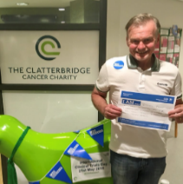
Bringing it all together - what will our strategy mean for patients, staff and our partners?
Based on extensive engagement and ‘active listening’ through the strategy development process, we know that…
Our patients want faster access to wrap-around care – treating the person, not just the cancer – and more opportunities to take part in clinical trials.
Our staff want to co-lead implementation of our future clinical model, opportunities to progress their careers at CCC, and support for innovation and new ideas.
Our partners want us to integrate research and care across C&M to support our contribution to delivering the best possible cancer outcomes.
Our new clinical model will deliver care which is faster and closer to patients’ homes. Care will be provided by a multi-disciplinary teams, available for extended hours. CCC care will be linked more closely to other cancer care and wider support – resulting in a single plan for all aspects of a patient’s care
The number of patients involved in clinical trials will double, and the range of trials will expand to include qualitative research into best practice in ‘whole-person care.’
Our staff will continually seek to improve the services they provide, including in response to patient feedback.
Our new clinical model and QI approach will give staff the opportunity to work together - across professions - to provide the best possible care and to change and improve their services.
Our development programmes will give our current and future leaders skills to lead not only in CCC, but also across our health and care system and nationally, in relation to both care and research.
Our greatly expanded research base and retained ECMC status will provide exciting opportunities for careers spanning cutting-edge research and outstanding care.
Our investment in CCC Liverpool and our hub based clinical model – supported by our significant investment in technology – will secure the capacity required to meet anticipated demand and access standards.
CCC clinical and managerial leaders will play an increasing role across the system in relation to all aspects of cancer care, treatment and prevention.
Our future research agenda –underpinned by our move to Liverpool – will significantly increase cross-system research collaboration, benefitting both patients and the local economy.
“It is really exciting to see CCC’s ambitions of influencing the wider system. It is refreshing that this strategy is being driven by a desire to provide the best possible care to patients. I certainly think that the more holistic approach to care combined with wider system engagement is a fantastic model”
John Archer – Principal Clinical Scientist
“I am living proof that research is saving my life. I was given 6 months to 2 years to live. I am now 3 years and 8 months later, still going strong”
Tony - CCC patient and participant in a clinical trial.
Excellence in care, research and innovation

Slide 24
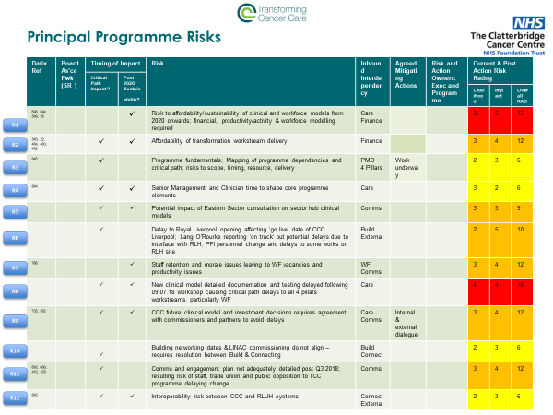
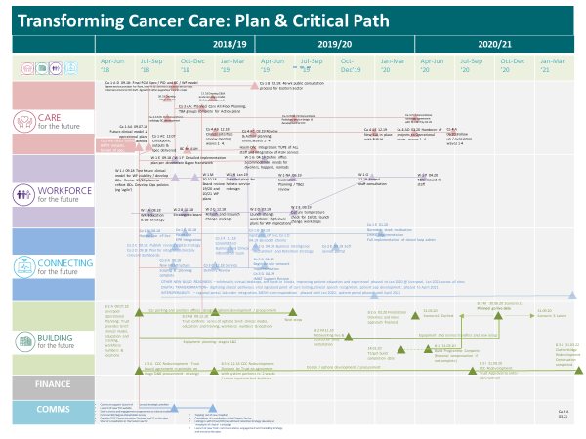
Implementation: Delivering the change
We will manage major change safely and effectively using evidence–based best practice approaches.
Implementation arrangements are in place for all elements of this strategy, overseen by the CCC Board.
Funding:
Funding has been identified and secured for all of the programmes outlined in this strategy. This includes:
Significant investment of £162m to underpin transformation of our services through the building of our new hospital in central Liverpool and the refurbishment our current hospital site.
£5.1m investment in IT/digital, supporting our new clinical model through the GDE programme.
Significant investment in additional workforce to support our clinical model and OD strategy, starting with £2.2m in 18/19
An additional £1.8m investment in research (supporting our research and innovation strategy).
Any further service developments during this time are contingent upon business cases and securing additional income.
Governance:
Implementation of the TCC Programme is overseen by our Executive Director of Transformation & Operations and a dedicated Programme Management Office (PMO), including risk assessment, moderation and escalation as well as programme co-ordination.
Key programme actions and interdependencies have been mapped to 2021, providing a risk-assessed critical path to guide implementation. It will also provide external assurance of risks and mitigation plans.
The PMO will be overseen by the CCC Finance and Business Development Committee, providing operational oversight and assuring the CCC Board (including escalation where required).
Clear board governance arrangements are also in place to oversee the delivery of other components of the strategy, including the Research and Innovation strategy and Organisational Development strategy (overseen by the Quality Committee).
These governance arrangements therefore follow best practice in ensuring clear oversight of delivery and the unambiguous accountability of the CCC Board for aspects of change. However, as the strategy itself makes clear, CCC cannot work in isolation. We will therefore work closely with our partners in implementing relevant aspects of change – in particular the Cheshire and Merseyside Cancer Alliance. The Alliance also provides the main vehicle for thinking about longer-term change beyond 2022 (see p. 21).
Excellence in care, research and innovation

Slide 25
Implementation: Delivering the change
We will manage major change safely and effectively using evidence–based best practice approaches.
We will also work closely with our Council of Governors (through its strategy sub-committee) as the strategy is implemented – and expect to provide regular updates for discussion and feedback. The committee will continue to provide valuable strategic advice as well as links to local communities and key partners.
Engagement:
Effective engagement with staff, patients and their families and key partners is vital to the success of every aspect of the strategy. Our key engagement activities are set out as part of ‘developing our outstanding staff’ above, including a communications and engagement cascade to all staff through senior leaders forum, which was re-formed with an extended remit and membership (taking in frontline clinical leaders) in September 2018.
This will be supported by a specific engagement programme for TCC, which includes:
A programme of staff communications and engagement on our new clinical model. Our goal is that every member of our staff feels personally involved in the implementation of the new clinical model – as a prelude to further, continuous improvement in the longer-term. We will work through existing departmental staff groups to ensure comprehensive engagement.
An external 360 degree stakeholder survey.
Developing a dedicated communications strategy to accompany our digital transformation (GDE programme).
Public consultation about implementation arrangements in the Eastern sector as part of our broader plans (from Autumn 2018).
We are currently revising our communications strategy. This will be published in January 2019 and will describe a communications approach which is aligned to our new clinical model and strategic objectives.
Realising wider social and economic value:
As part of the construction of the new Cancer Centre, the Trust’s wholly owned subsidiary PropCare is working with partners to ensure the construction project makes a contribution to the local economy and communities in the area.
The project’s social value committee oversees a community benefit plan, which has targets across a number of areas. These include the use of local labour and local suppliers, the creation of sustainable apprenticeships, a review of the number of women on the project, and work with local schools and colleges on digital engineering and construction as a career choice.
The project also seeks ways of working with third sector organisations, for example through the use of their income generating services, or through provision of help and expertise from project staff to support them in their operation.
The project is meeting or exceeding its targets for the generation of social value and this work will remain an important part of the project as it moves towards completion.
Excellence in care, research and innovation

Slide 26
Implementation: How will we measure success?
We will track implementation of this strategy through a small number of ‘headline’ metrics, underpinned by more detailed reporting.
We track a large number of measures related to all aspects of the care we provide, as well as how this translates into clinical outcomes and positive experience for our patients. Listed opposite are the headline measures which we will use in tracking the implementation and success of this strategy. For this reason they:
Provide a headline picture of progress against the strategy's objectives as a whole. Identifying a small number of headline measures allows a simple mechanism for tracking progress with the strategy as a whole – including accounting for progress to our staff, partners and patients. Behind these headline measures, we will track a much larger range of indicators in order to guide implementation teams.
Include a mixture of process, output and outcome measures. This will allow us to track both specific actions in the short term (process and output measures) and ensure that this is translating into real change for our patients and staff in the longer-term (outcome measures). Although our ultimate focus is on outcomes, we must ensure that changes can be related effectively to specific actions we have taken as part of this strategy.
All strategic priorities will be monitored within the context of maintaining our excellent quality, operational and financial performance. It is also important to note the context of significant anticipated increases in demand for many of our services in coming years.
Further information on the relationship between the key elements of this strategy and desired outcomes and benefits (for patients, families, staff and partners) is enclosed at Appendix D.
Strategic priority | Key success measures (headlines) | Baseline | Target (2022)
CCC Liverpool and our new clinical model | 62 day performance (incorporating 7 day first seen and 24 day treatment standards). | >85% | Sustained
 | CCC patients have seamless access to all supporting acute services. | n/a | In place
 | Improved clinical outcomes – demonstrating outcomes comparable to the best cancer centres in our peer group. | Significant evidence of development
 | Accessibility of a “sector hub” within 45 minutes travel - providing more comprehensive and equitable cancer care closer to home. | Not in place | 90% coverage
 | Maintain or improve patient experience (Friends and Family Test and Inpatient Experience Survey) | Top decile | Top decile*
Investing in research and innovation | Number of patients recruited into clinical trials. | 526 | 1000
 | Percentage of research portfolio consisting of qualitative or observational studies. | 11% | 20%
 | ECMC status. | Achieved | Retained
Developing our outstanding staff | Staff Engagement score (out of 5). | 3.96 | Top decile*
 | Staff agreeing that “Our values and behaviours are embedded within the culture of CCC” (staff survey local) | 73% | 80%
 | Staff contribution to Quality Improvement (NHS Staff Survey, KF7). | 75% | Best in class*
System leadership – Performance across C&M** | Total transformation funding provided by the National Cancer Programme Team to C&M. | £9M | £20M
 | Overall patient satisfaction with cancer care. | 91% | Best in class*
 | Survival rates - one year*** | 72-75% | 75%
 | Survival rates - ten years*** | 49.8% | 57%
 | Early stage diagnosis (Stage 1 or 2)** | 49-55% | 62%
* “Best In Class / Top Decile” refers to the Acute Specialist Trust grouping from the NHS Staff Survey.
**Early stage diagnosis planned for 2021 delivery as per national cancer strategy.
***For patients diagnosed in 2020 (baseline represents all England position)
Excellence in care, research and innovation

Slide 27
APPENDIX A: Our priorities form a mutually-reinforcing programme of action to allow us to realise our vision.
Our two supporting strategic priorities – maintaining excellent quality, financial, and operational performance and being enterprising cut across all of our strategic actions.
 |  | A new flagship hospital in Liverpool. | A new ‘tiered’ clinical model | Integrate haemato-oncology services across the region. | Global digital exemplar programme | Play a pivotal role in the C&M Cancer Alliance. | Work through the Alliance to develop a ten-year plan. | Double patient participation in clinicat trials | Become renowned for qualitative research. | Double number of studies with CCC as sponsor. | Develop a ‘research active workforce.’ | Maintain ECMC status | Culture of Safety & Quality | Quality Improvement | Engagement | Leadership development and succession planning | Values & Behaviours
CCC Liverpool and our new clinical model | A new flagship hospital in Liverpool. |  | ü | ü | ü | ü |  | ü | ü | ü | ü
 | A new ‘tiered’ clinical model | ü |  | ü | ü | ü |  | ü | ü | ü | ü |  | ü | ü | ü | ü | ü
 | Integrate haemato-oncology services across the region. |  | ü |  |  | ü |  |  |  |  |  |  | ü | ü
 | Global digital exemplar programme | ü | ü |  |  | ü |  | ü |  |  |  |  | ü | ü |  |  | ü
System leader-ship | Play a pivotal role in the C&M Cancer Alliance. | ü | ü | ü | ü |  | ü |  |  |  |  | ü |  | ü | ü | ü | ü
 | Work through the Alliance to develop a ten-year plan. |  | ü |  | ü | ü |  |  |  |  | ü | ü | ü | ü | ü | ü | ü
Investing in Research and Innovation | Double patient participation in clinical trials |  | ü |  |  | ü | ü |  | ü | ü | ü | ü |  | ü | ü |  | ü
 | Become renowned for qualitative research. |  | ü |  |  | ü | ü | ü |  | ü | ü | ü | ü | ü | ü |  | ü
 | Double number of studies with CCC as sponsor. |  | ü |  |  | ü | ü | ü | ü |  | ü | ü | ü | ü | ü |  | ü
 | Develop a ‘research active workforce.’ |  | ü |  |  | ü | ü | ü | ü | ü |  | ü | ü | ü | ü |  | ü
 | Maintain ECMC status |  | ü |  | ü | ü | ü | ü | ü | ü | ü |  | ü | ü | ü |  | ü
Developing our outstanding staff | Culture of Safety & Quality | ü | ü | ü | ü | ü | ü | ü | ü | ü | ü | ü |  | ü | ü | ü | ü
 | Quality Improvement | ü | ü | ü | ü | ü | ü | ü | ü | ü | ü | ü | ü |  | ü | ü | ü
 | Engagement | ü | ü | ü | ü | ü | ü | ü | ü | ü | ü | ü | ü | ü |  | ü | ü
 | Leadership development and succession planning | ü | ü | ü |  | ü | ü |  |  |  | ü | ü | ü | ü | ü |  | ü
 | Values & Behaviours | ü | ü | ü | ü | ü | ü | ü | ü | ü | ü | ü | ü | ü | ü | ü
Support which other actions…
Which of our strategic priority actions…
Excellence in care, research and innovation

Slide 28
APPENDIX B: New Clinical Model – Service Availability by location type
Element of Networked Model | Rationale for element | Services available
Home, work or community settings (population covered 1+) | Care should be provided as close to patients as possible, including maximising the range of services we can provide in home or work settings. | Chemotherapy – our unique CCCChemo@home and CCCChemo@work services. Telehealth services Patient portal – patient access to their own care and information.
Local Hospital (200,000) | The majority of both treatment and follow-up appointments for common cancers (more than 1400 new patients per year) should be provided locally. | Acute oncology Chemotherapy levels I and II Outpatient follow-up appointments Multi-disciplinary team (“MDT”) input
Clatterbridge Sector Hub (500,000) | Our four sector hubs (one of which is co-located with the Centre) will provide the scale necessary to host a seven-day service provided by multi-disciplinary teams of tumour-site-specific specialists for common cancers. They will provide optimal clinical care for first appointments for common cancers. They will then co-ordinate ‘whole person care’ by linking with relevant local services and other elements of cancer care (for example surgery) to ensure that patients’ care if co-ordinated. Sector hubs will also provide treatment for most intermediate cancers (500-1400 new patients per year) – including head and neck (at three hubs), skin, gynae, HPB, bladder and kidney cancers. First appointments for intermediate cancers will be either at The Centre, or at specific centres of excellence for specific cancers (see next page).Sector hubs will also provide local hospital services. | Acute oncology and assessment unit Chemotherapy levels I, II and III First and follow-up outpatient appointments Follow-up outpatient appointments On-site supportive care MDT input Oncologist base Phase III clinical trials Outreach clinical trials team Radiotherapy in 3 Clatterbridge sector hubs (image guided radiotherapy and Intensity-modulated radiation therapy)
The Centre (2 million) | Our new hospital will provide a centre of excellence for rare cancers (fewer than 500 new patients per year – including testes, penile, brain and ocular cancers) and the most complex treatments which require centralised specialist expertise. It will also provide inpatient beds and access to critical care for our sickest patients. It will allow us to provide a wider range of innovative and experimental treatments linked to clinical trials. The Centre will also provide sector hub and local hospital services. | Comprehensive acute oncology service Chemotherapy levels I, II, III and IV Inpatient beds Outpatient new and follow up appointments Radiotherapy (image guided radiotherapy and Intensity-modulated radiation therapy) Complex radiotherapy On-site supportive care On site MDT input Oncologist base Phase I onwards clinical trials On site clinical trials team
Excellence in care, research and innovation

Slide 29
APPENDIX B: New Clinical Model – Cancer pathways by location (subject to public consultation where appropriate)
Cancer type |  | 1st CCC Consultant appointment | Clatterbridge Consultant follow-up appointment | Treatment (SACT) delivery and on treatment review*
Common cancers (more than 1400 new patients per year) | Breast | 4 Clatterbridge sector hubs | Nearest local hospital | Nearest local hospital
 | Lung | 4 Clatterbridge sector hubs | Nearest local hospital | Nearest local hospital
 | Colo-rectal | 4 Clatterbridge sector hubs | Nearest local hospital | Nearest local hospital
 | Prostate | 4 Clatterbridge sector hubs | Nearest local hospital | Nearest local hospital
 | Rectal | CCC-Liverpool, CCC-Wirral | Nearest local hospital | Nearest local hospital
 | Prostate | CCC-Liverpool, Broadgreen Hospital | Nearest local hospital | Nearest local hospital
Intermediate cancers (500-1400 new patients per year) | Head and Neck | CCC-Aintree | CCC-Wirral, CCC-Aintree | CCC-Liverpool, CCC-Wirral, CCC-Aintree
 | Skin | CCC Liverpool | CCC-Liverpool, St Helens | 4 Clatterbridge sector hubs and community
 | HPB | CCC-Liverpool | CCC-Liverpool | 4 Clatterbridge sector hubs and local hospitals
 | Gynae | CCC Liverpool, Liverpool Womens[TBC] | CCC-Liverpool, CCC-Wirral, East area hub (site TBC) | 4 Clatterbridge sector hubs
 | Bladder | CCC-Wirral, Broadgreen Hospital | CCC-Liverpool, CCC-Wirral | 4 Clatterbridge sector hubs
 | Kidney | CCC-Liverpool | CCC-Liverpool | 4 Clatterbridge sector hubs
 | Cancer unknown primary | Linked to acute oncology with the trials service at CCC-Liverpool. OPD MOU at CCC-Liverpool and three hubs. |  | 4 Clatterbridge sector hubs and local hospitals
Rare cancers (fewer than 500 new patients per year) | Testis | CCC-Liverpool | CCC-Liverpool | CCC-Liverpool
 | Penile | CCC-Liverpool | CCC-Liverpool | CCC-Liverpool
 | Brain/CNS | CCC-Liverpool | CCC-Liverpool CCC Aintree/Walton Neuro | CCC-Liverpool CCC Aintree/Walton Neuro
 | Sarcoma | CCC-Liverpool | CCC-Liverpool | All sector hubs
 | Ocular | CCC-Liverpool CCC-Wirral (Protons) | CCC-Liverpool CCC-Wirral | CCC-Liverpool CCC-Wirral
Haematological Cancers (North Mersey) | Lymphoma | CCC-Liverpool, CCC-Aintree, Southport General Hospital | CCC-Liverpool, CCC-Aintree, Southport General Hospital | CCC-Liverpool, CCC-Aintree, Southport General Hospital
 | Myeloma | CCC-Liverpool, CCC-Aintree, Southport General Hospital | CCC-Liverpool, CCC-Aintree, Southport General Hospital | CCC-Liverpool, CCC-Aintree, Southport General Hospital
 | Leukaemia | CCC-Liverpool, CCC-Aintree, Southport General Hospital | CCC-Liverpool, CCC-Aintree, Southport General Hospital | CCC-Liverpool, CCC-Aintree, Southport General Hospital
 | Stem cell transplant | CCC-Liverpool | CCC-Liverpool | CCC-Liverpool
*All SACT will be risk stratified and treatment delivered in the most clinically appropriate place
**Specialist inpatient care for patients with haematological cancers will be provided at CCC-Liverpool
Excellence in care, research and innovation

Slide 30
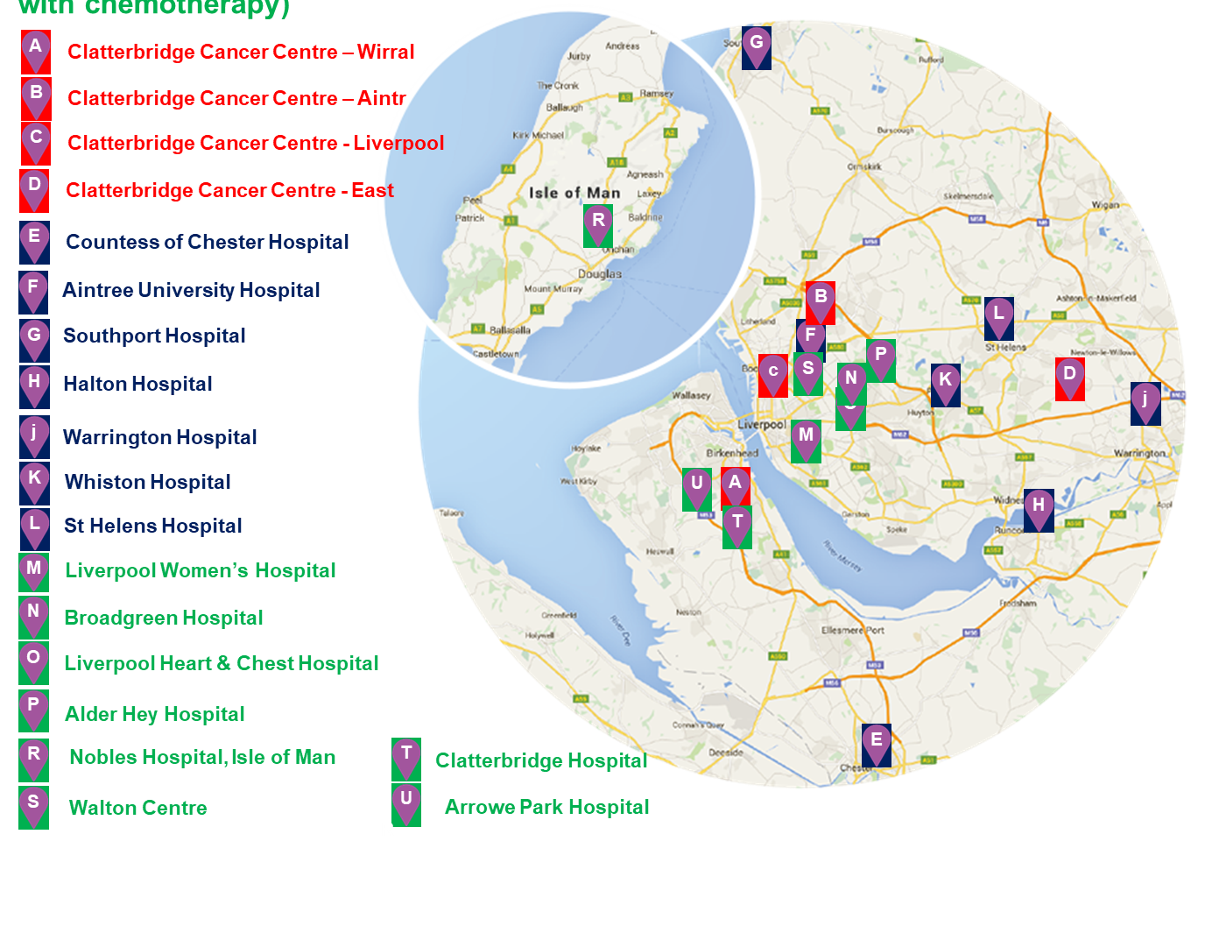
APPENDIX B: New Clinical Model – Service Locations
Clatterbridge Sector hub and The Centre
Local hospitals
Other outpatient sites (tumour hubs – some with chemotherapy)
Note: Location/Plan for site “D” is subject to public consultation activity from Autumn 2018 (shown in the middle of the “East” sector for reference purposes only). Where pathways change linked to the planned new clinical model, appropriate engagement will take place.
Excellence in care, research and innovation

Slide 31
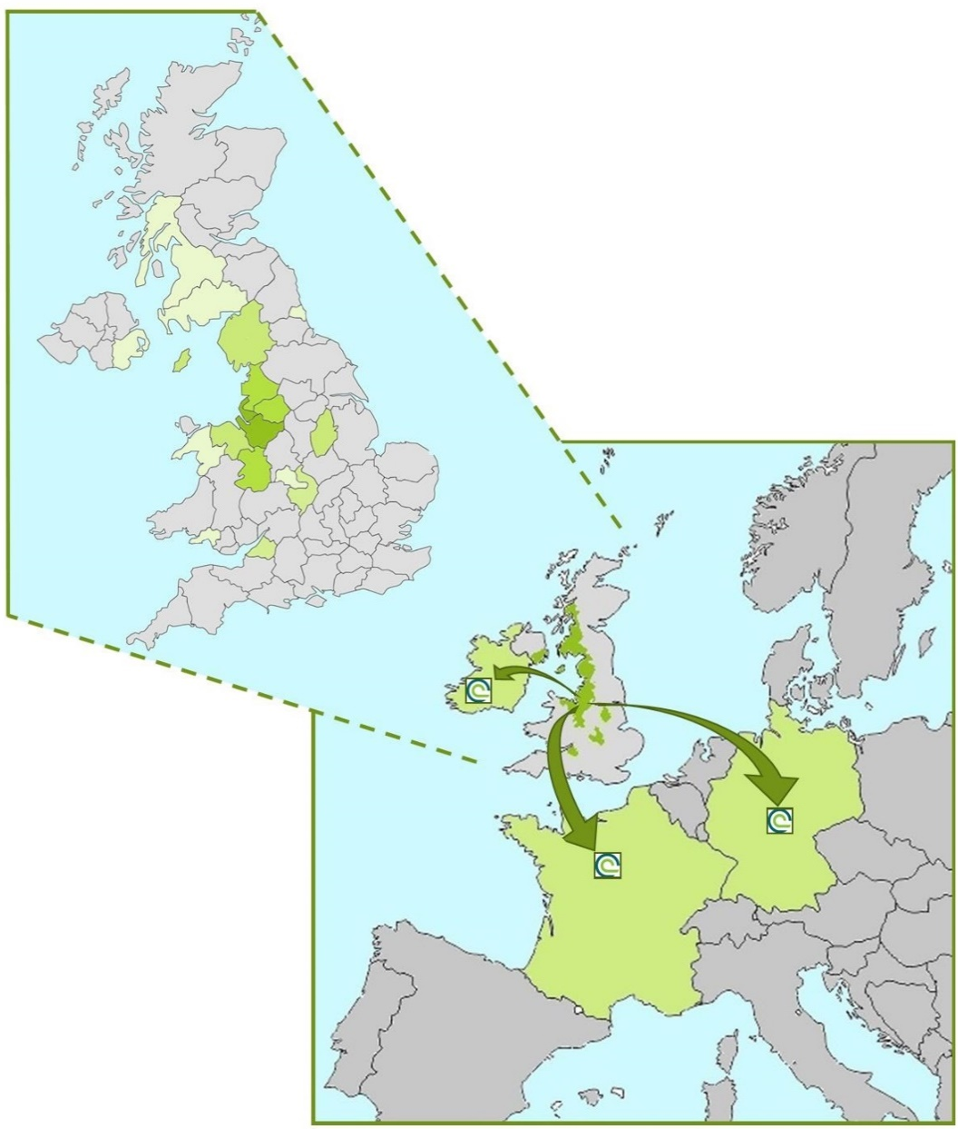
APPENDIX C: CCC Research – our national and international reach
Offering an opportunity to take part in research to all
We provide excellence in care, research and innovation by staying at the forefront of new treatments, therapies, technologies and techniques to deliver more effective and personalised treatments than ever before.
CCC has a strong, dynamic portfolio of clinical trials and research studies that brings the best in novel treatments and care to our patients.
Being 1 of only 15 CRUK funded ECMC (experimental cancer
medicine centres) in the UK means we can offer early phase trials and cutting edge treatments.
CCC not only serves our region but also patients from all
over the UK benefit from our service and expertise in compassionate cancer care and research.
Patients from all around the UK come to CCC to access novel therapies and clinical trials.
CCC Sponsored Research
We are proud to support our research focused clinicians in their leadership of exciting new
interventional studies by acting as Sponsor for clinical trials.
CCC-led studies are available to patients in hospitals in Germany, France and Ireland.
Excellence in care, research and innovation

Slide 32
APPENDIX D: Linking our strategic Priorities to Long-term Outcomes and Benefits
Strategy INPUTS
Strategic priority ACTIONS
OUTPUTS from implementing the strategy (to 2022)
OUTCOMES and BENEFITS for patients, staff and our partners
Outstanding quality cancer care
CCC Liverpool operational
Sector hubs operational (including East)
Improved one-year cancer survival (75%)
Improved ten-year cancer survival (57%)
Implementing CCC Liverpool and our new clinical model
TCC Programme agreed
Integrated clinical pathways in place
Digitally-enabled care via GDE programme
Reduced mortality rate (lower than current 700 excess deaths)
CCC recognised as Outstanding by CQC – particularly ‘safe’ and ‘effective’ domains
Collaborative system leadership
Capital investment programme – secured funding
Research and Innovation strategy implemented
OD strategy implemented
93% of patients access care within 45 minutes of home
Improved patient experience through holistic, integrated cancer care (FFT top decile)
Investing in research and innovation
System leadership via C&M Cancer Alliance
An agreed ten-year plan for care across the system
Long-term financial strength maintained (NHSI risk rating min. 2)
Improved staff engagement (top decile)
Improved leadership capability (CCC and systemwide)
Developing our outstanding staff
Research portfolio and treatment innovation
Better Collaborative System Leadership
Patient experience top 10%
CCC is ‘recognised for leading edge research and innovation’
More patients access innovative treatments via research / trials (minimum 1000 p/a)
Excellence in care, research and innovation

