Slide 1




My Papillon Journey Past, present and the future .… ... .. .
H2020 CAST project MSCA-ITN-857894
Arthur Sun Myint
Lead Clinician ( Papillon)
Clatterbridge Cancer Centre
Hon Professor University of Liverpool
Research and Innovative Grand Rounds
Clatterbridge Cancer Centre -17th September 2021

Slide 2

Disclosure
No conflict of interest to declare.
Our Papillon research project has received funding from the European Union's Horizon 2020 research and innovation programme under the Marie Sklodowska-Curie grant agreement No.857894

Slide 3
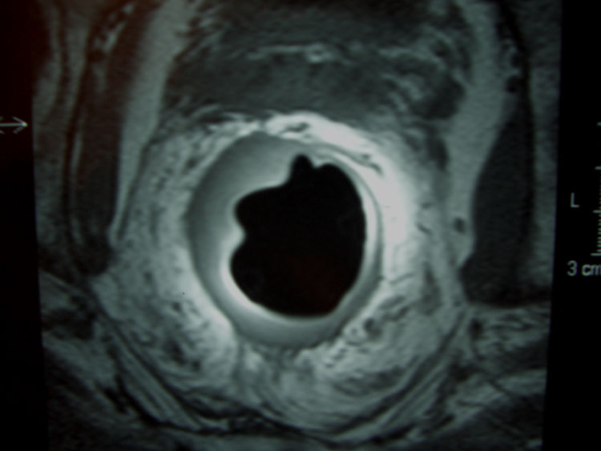
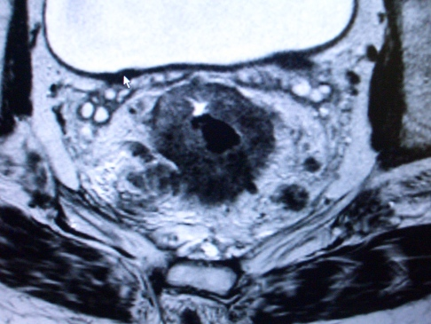
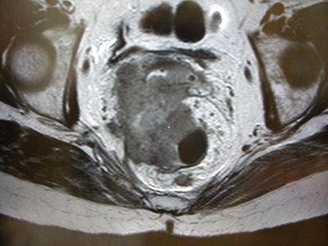
The Standard of Care for Rectal Cancer
Surgery
Surgery
EBCRT Surgery
T1 /T2 /T3a
N0 /M0
<3cm
Mobile polyp
T3b <5mm
N1 /M0
>3cm
CRM(-) ive
T3c + /T4
N2 /M0
>3cm
CRM (+) ive
The Good
The Bad
The Ugly
No radiotherapy usually offered as standard of care
Pre op CRT offered as standard of care
Early rectal cancer
Advanced rectal cancer
NICE 2020
Do not use preoperative radiotherapy in early rectal cancer unless as part of a trial

Slide 4
Variations in radiotherapy (English NHS)
No RT 50.7%
SCRT – 12.1%
SCRT-D 1.2%
LCCRT 29.5%
PORT 2.3%
Other 4.7%

Slide 5
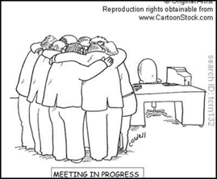
Multi disciplinary Team meeting
Organ preservation
is not an option
in most colorectal MDT meetings as it is not recommended in the guidelines
The MDT recommendations are based on protocols, guidelines and published evidence. MDT decides what is best for the patient. Not on the patient’s choice or what they want.

Slide 6
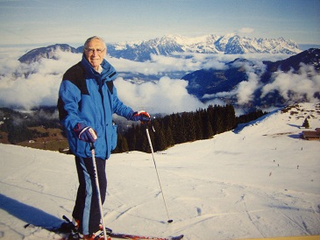
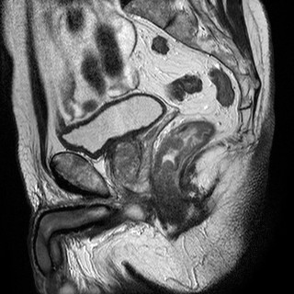
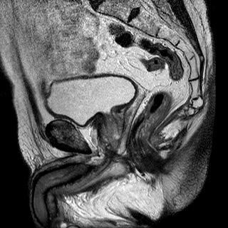
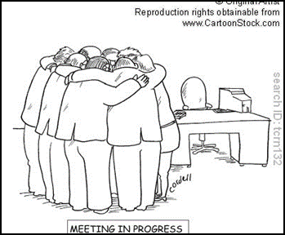
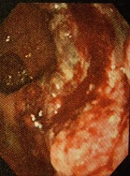
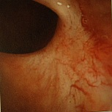
Our patient’s story ……..
79 years old retired lecturer who wanted to go skiing after being diagnosed with rectal cancer in 2009…..
Pre EBCRT (T3N2)
Post EBCRT(cT0cN0)
Permission obtained from the patient
“The courage of patients like ‘Don’ who
refused surgery was an inspiration
for my journey…”
Before
After treatment
His surgeon wanted to operate on him, but the patient refused and went skiing instead…..

Slide 7
The problem
The dilemma is what to do when some older patients who are medically fit but refused surgery as he doesn’t want a stoma.
We have to think of an innovative way to solve this problem of patient’s choice against the dogma of the ‘Gold Standard of Care 'which most MDT usually recommends.

Slide 8
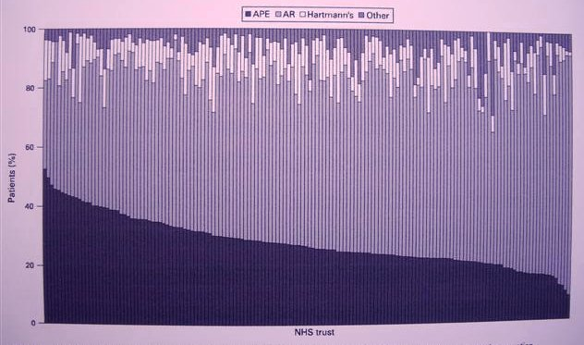
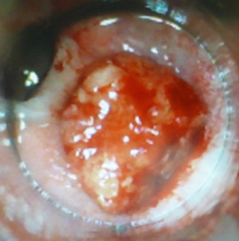
Variations in APR rates in NHS (1998-2004)
Time to Intervene?
32% of patients who had APER were Dukes’ A
E Morris, P Quirk, B Cottier et al Gut (2008)57: 1690-1697

Slide 9
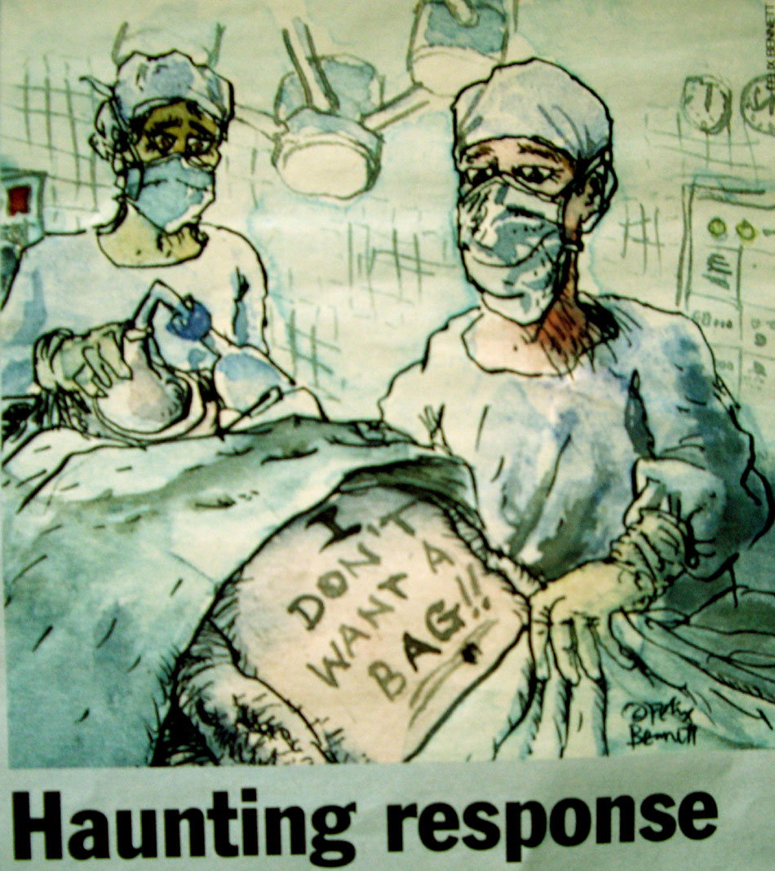
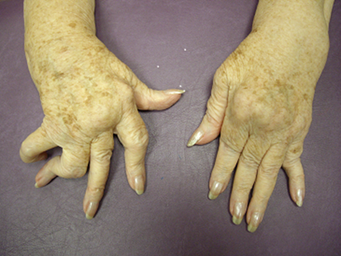
Some patients do prefer a box than a bag
High stoma rates 40%
Not all are suitable for a stoma
Resource
NBOCAP data 2015
Morris et al Gut 2008

Slide 10
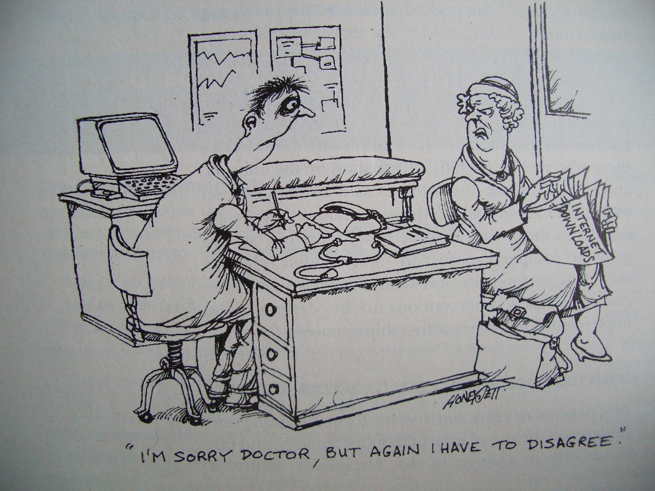
Do patients have a choice?
I am sorry… Doctor, I have to disagree
Surgery
“Our computer says; ‘surgery’ is the best treatment option for you”

Slide 11





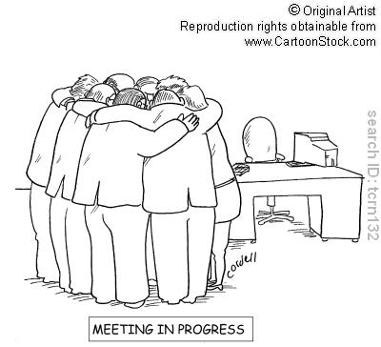

“The gold standard of care”
Patient’s choice
It is a very fine balance
Standard of Care
No stoma
Surgery
MDT
protocols
MDT
guidelines
Benefits
Risks
Cure
Survival
QOL
Recurrence
Death
Complications

Slide 12
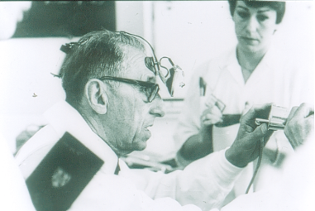
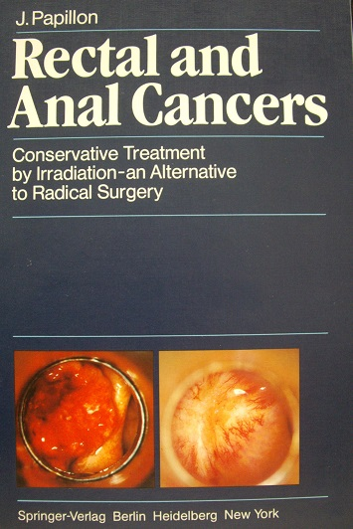
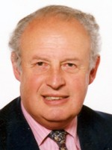
Prof Jean Papillon
My Bible
(1914 -1993)
Popularised Contact Radiotherapy using Philips machine
Set up facility in Lyon in the early 60’s
Continue until early 90’s
Practice for over 30 years
Treated 312 patients
Prof Chris Marks
Guildford

Slide 13
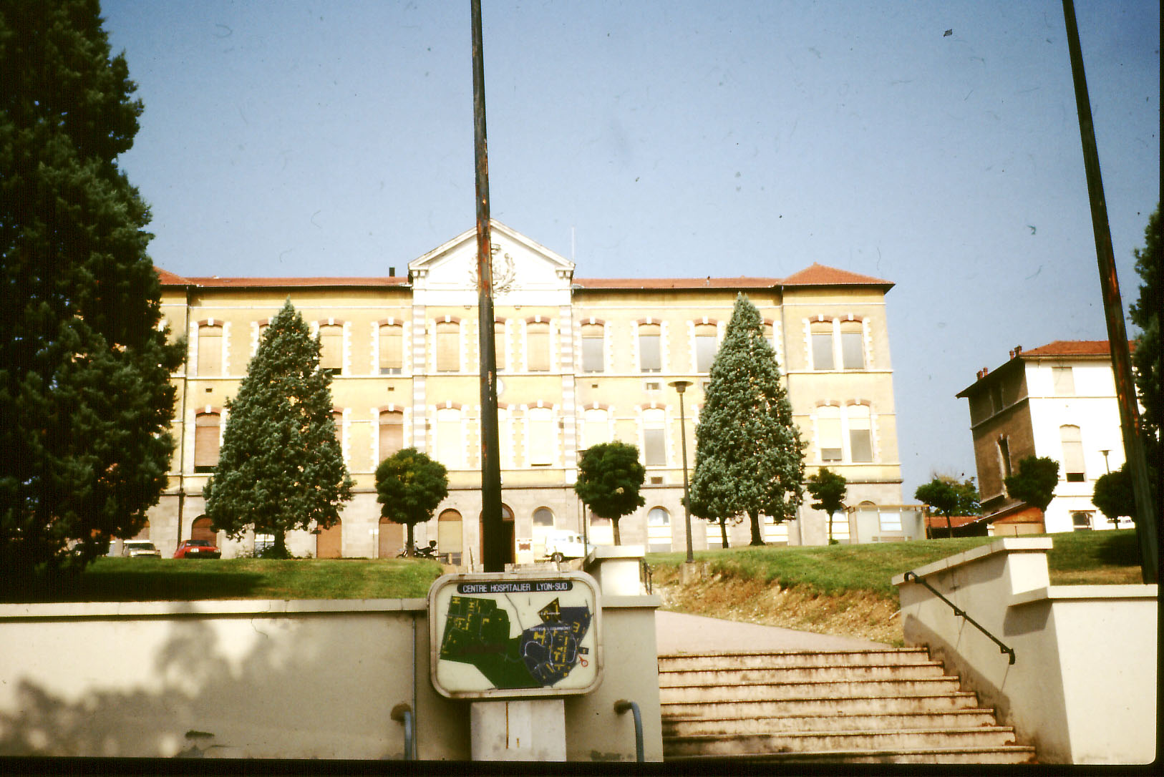
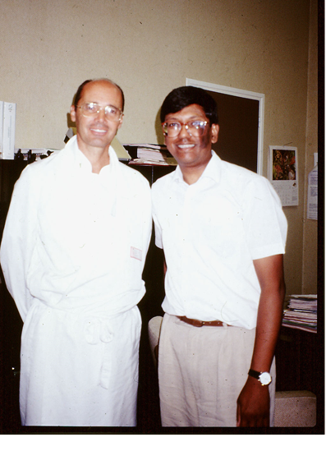
Clatterbridge’s team visited Lyon (1992)
Dr Sun Myint (Team leader)
Mr Chris Rymel (Physicist)
Ms Janet Taylor (Radiographer)

Slide 14
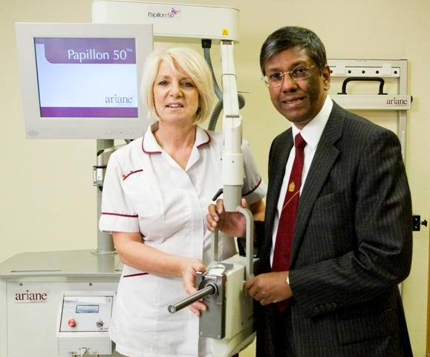

Papillon 50 Ariane machine (2009)
Howards from Southport
Our patients raised 100K through two charity events

Slide 15

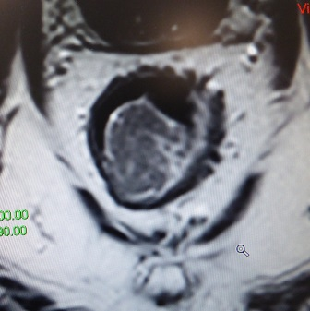
WHO?
Patients not suitable for surgery or refusing surgery
Rectal adenocarcinoma (early cancer & low risk)
Stage cT1 or cT2 (cT3a) confine to bowel wall
<3cm (one third of circumference or less)
Histologically- well to mod. differentiated
Clinically - Mobile exophytic tumour
Within 12cm from anal verge
Staging- MRI (rT1/T2/T3a) / uT1(EUS)
No suspicious lymph nodes (N0)
Sun Myint et al. Colorectal Dis. 2019 Mar;21 Suppl 1:45-52.

Slide 16
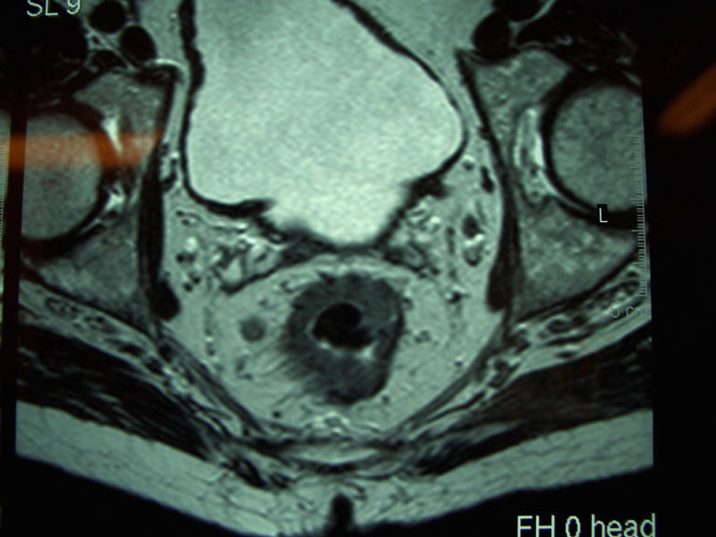
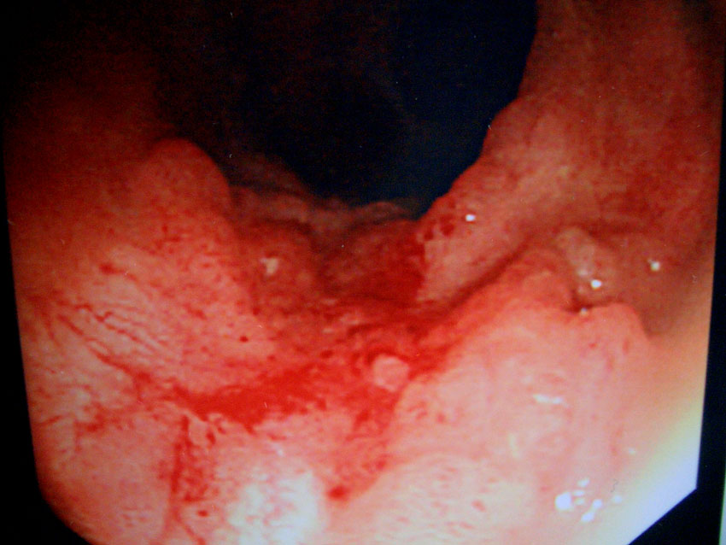
Exclusion Criteria
Patients not suitable for radical curative Papillon
Poorly differentiated adenocarcinomas
Lympho vascular invasion - LVI(+)
Tumour budding
Suspicious lymph nodes
Mucinous tumours

Slide 17
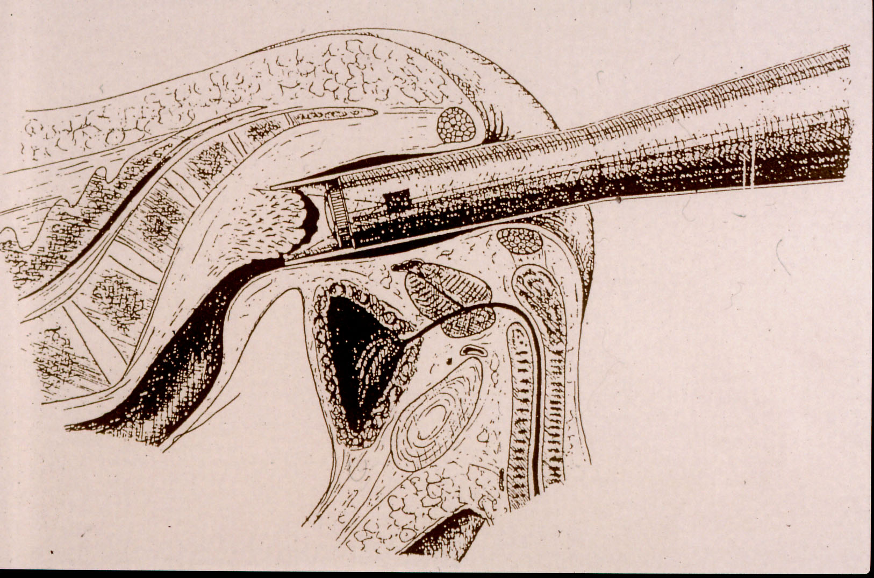
How we do Papillon?
Low energy X-rays (50KeV)
High dose (90Gy) EQD² 300- BED 360
Targeted directly on tumour
No collateral damage
Less side effects
Contact RT delivers low energy (50 KeV), very high radiation dose (30Gy) to a small volume targeted directly on the rectal tumour which kill cancer cells layer by layer at each treatment sessions every 2 weeks x 3 times

Slide 18
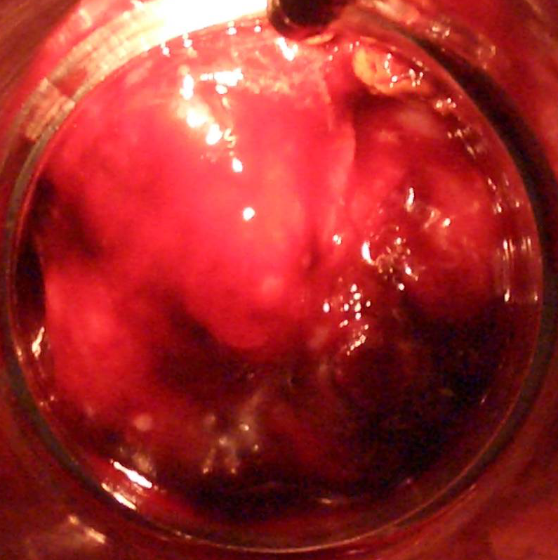
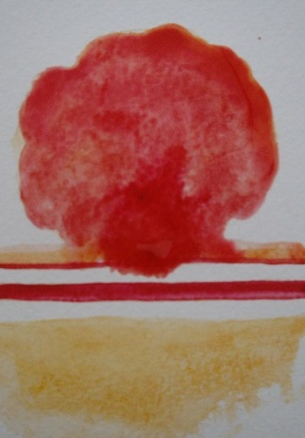
Pre treatment 3cm cT1cN0cM0
08.11.05 Day 0

Slide 19
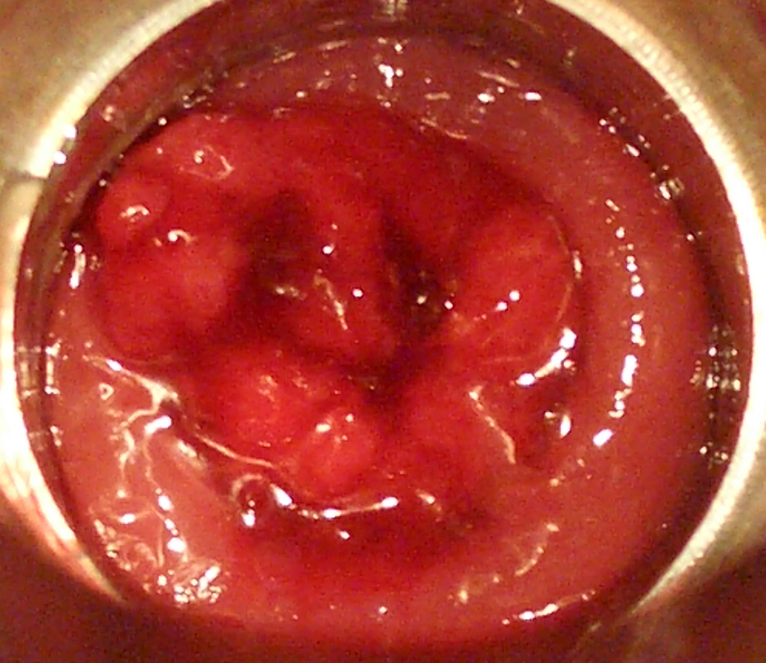
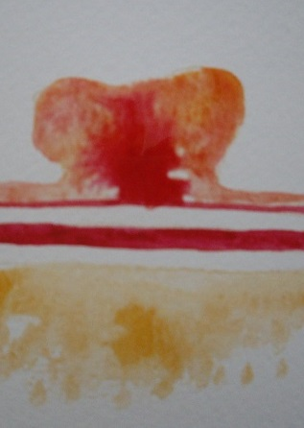
After one fraction
80% regression
22.11.05 D 14

Slide 20
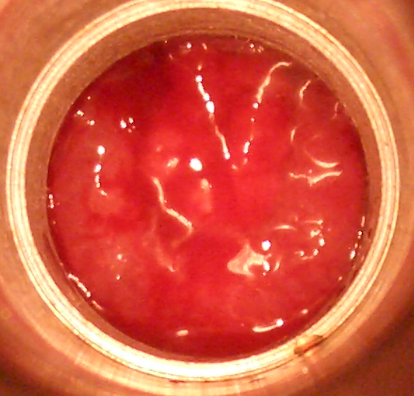
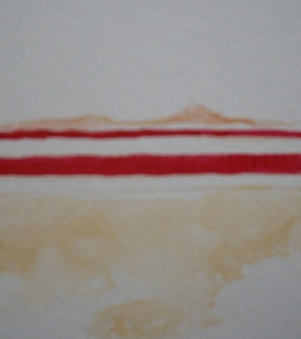
After two fractions
No residual tumour
06.12.05 D 28

Slide 21
Treatment position and depth dose
EQD2= 300
BED = 360
EQD²= 82
BED = 123
Sun Myint et.al. Int J Rad Oncol Bio Physics 2018;100(3): 565-573

Slide 22

When?
1. Early rectal cancer cT1/cT2 cN0 <3cm, mobile & exophytic
Start with Papillon alone
+/- EBRT (when necessary)
2. Post op Following TEMS/TAMIS (pT1 cN0)
(R1), (Rx), high risk features LVI(+),G3
3. Advanced cancer cT3 cT4 cN1-2 >3cm CRM(+)
Start with EBCRT/SCRT- to down size/stage
Select responders – CXB boost
Not suitable for surgery or refusing (stoma phobic)
Sun Myint et al. Colorectal Disease 2019; 21: Issue S1 45-52
Dhadda et al. Radio & Oncology 2021; 162:195-201

Slide 23
How we select our patients ?
08.11.05 (Day 0)
22.11.05 (D 14)
06.12.05 (D 28)
We tailor management according to our patient response
Good responders - No residual tumour - Wait & Watch (no surgery)
Partial responders - Small residual tumour - TEMS/Tamis (Keyhole- local)
Poor responder - Residual tumour - Need Surgery (TME)
No available biological markers at present to predict response
Sun Myint et al. B J Radiology 2017
10.01.06 ( D 62)

Slide 24
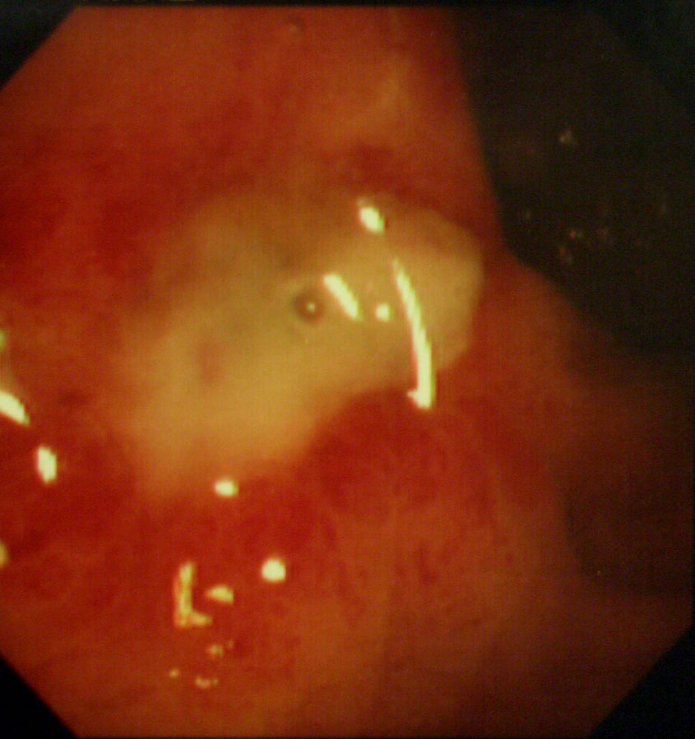
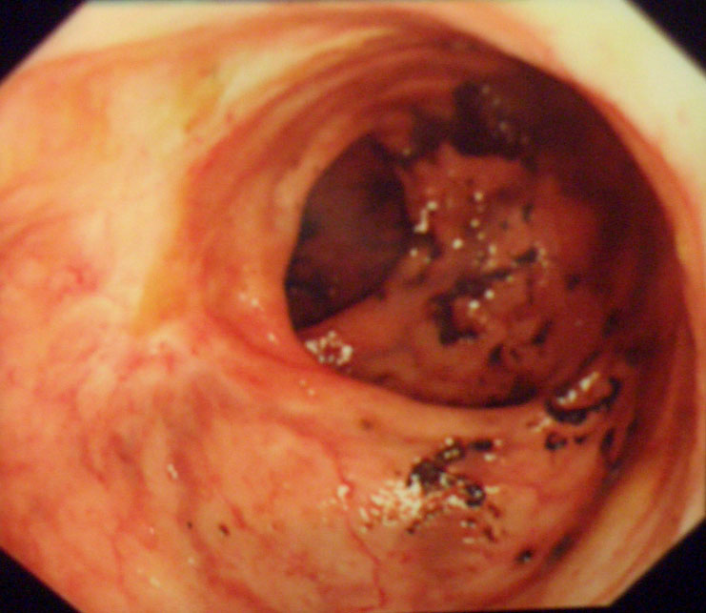
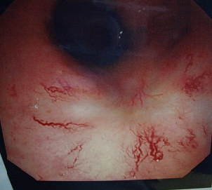
Side Effects
Acute
Radiation ulcer (27%)-heals
No biopsy please
Late
G1/G2 Bleeding-38% (Argon 10%)
Stenosis 0% (1% in initial cohort)
Fistula 0% ( 1% in initial cohort)
No treatment related mortality
(usually heals in 6- 12 months)
Papillon scar with telangiectasia
Sun Myint A et al. Colorectal Disease (2013) NCRI Poster
NICE – Interventional Procedure Guidance IPG 532 (2015)

Slide 25
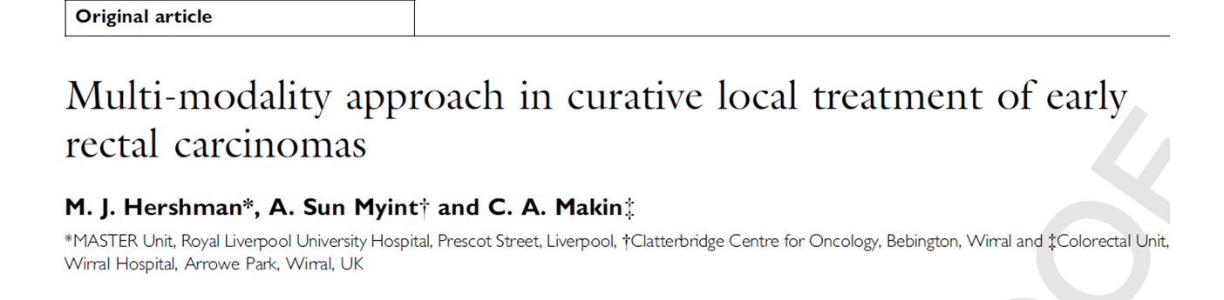
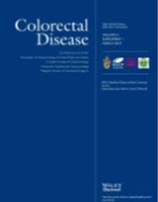
1993-2002 First n=100 patients highly selected patients treated for cure
Male=55 Female 45 cT1= 53 cT2-29 cT3=6 NA= 5
Age = 73 years ( range 49-91)
Surgery alone = 13
Radiotherapy Pre op = 33 / Post op= 25 / Radical (no surgery)= 29 patients
Median Follow up= 33months ( 3-120)
Overall survival =77% (at median 33 months)
Cancer specific survival = 96%
Colostomy free survival = 91%
Local recurrence =10% (6/10 had salvage surgery)
Deaths = 16 patients ( only 4 due to cancer)
Hershman et al. Colorectal Disease 2003; 5: 1-6

Slide 26
Contact RT in early rectal cancer
Country No LC Survival
PAPILLON F 312 91% 85%
GERARD F 106 87% 78%
MAINGON F 15 81% 67%
SISCHY USA 227 95% 92%
DE GARAC Canada 55 84% 87%
MYERSON USA 199 80% 86%
MENDENHALL USA 34 85% 90%
SCHILD USA 20 90% 76%
SUN MYINT UK 220 89% 75%
Sun Myint et al Clinical Oncology (2007);19:9

Slide 27
Care pathway for patients (1993-2007)
Rectal cancer (1993-2007)
EBRT +CXB +/- TEMS
n=220
Draw backs
Not MRI stage
No stage or size information
No endoscopic pictures
No MDT before 2000
n=220
Multi modality EBRT+CXB+TEMS
Surgery alone 22 pts excluded
Assessment 6-8 weeks (12-14wks)
Complete clinical response
196/220 ( 89%)
In complete response
24/220 ( 11%)
cCR 89%
Sustained cCR
176/ 196 ( 90%)
Local regrowth
20/196( 10%)
Surgery (ISS)
21/24 (87.5%)
Palliative
3/24 (12.5%)
Sustained cCR 80%
Local +Distant relapse
2/196 ( 1%)
Distant relapse
7/196 ( 3.5%)
Local only
11/196( 5.5%)
Palliative
2/11 (18%)
Surgery(DSS)
7/11 (64%)
CXB retreatment
2/11 (18%)
Hershman, Sun Myint Clinical Oncology 2007; 19:720-723

Slide 28
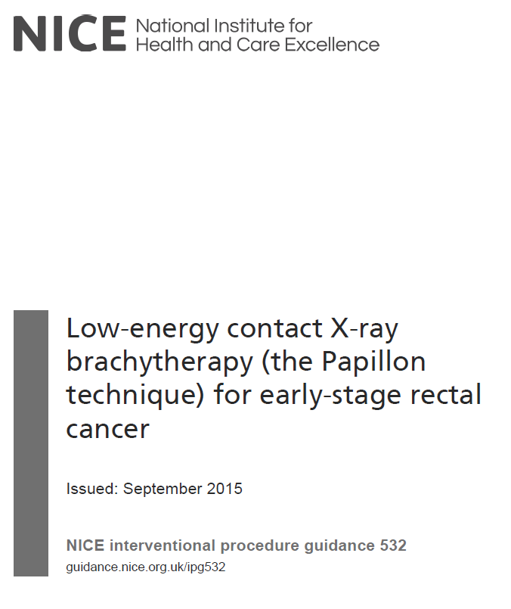
Safety and efficacy of Papillon is acceptable for patients not suitable for surgery
IPG 532 NICE (2015)

Slide 29

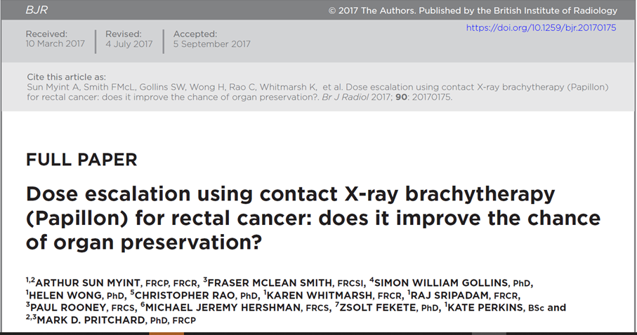
2003-2012
n=200
CXB alone 17 (8,5%) All had EBCRT or SCRT + CXB
cCR = 72% (144/200)
Local regrowth = 11% (16/144)
Maintained cCR = 86% (124/144)
Advantages
Independent review of data
Proper staging with MRI
Size and height information
All discussed at MDTs
Sun Myint et al. BJR 2017; 90: 108020170175.

Slide 30
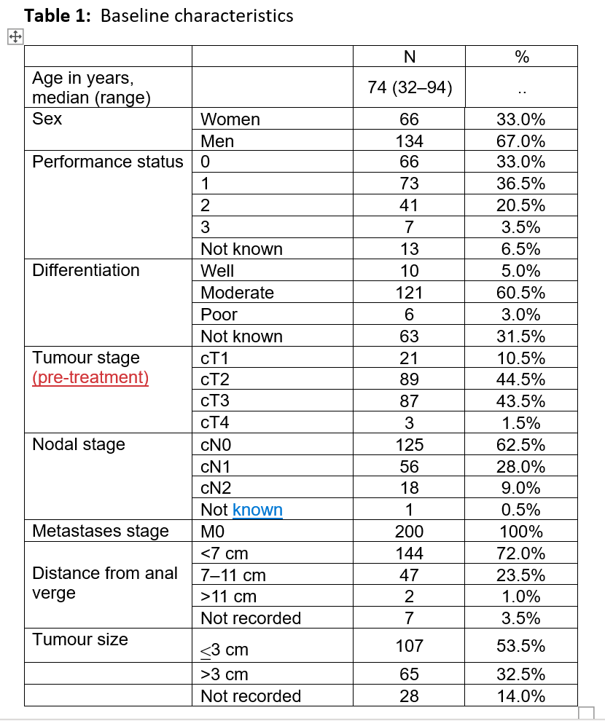
cT3=43.5%
cN1=28.0%
Sun Myint et al. BJR 2017

Slide 31
Care pathway of patients (2003- 2012)
Rectal cancer any T,N, M0
EBRT /SCRT+CXB
n= 200
cT1= 10.0% cN0= 62.5%
cT2= 44.5% cN1= 28%
cT3= 43.5% cN2= 9%
cT4= 1.5%
Size <3cm = 53.5%
>3cm = 32.5%
Assessment 6-8 weeks (12-14wks)
Complete clinical response
144/200 ( 72%)
In complete response
56/200 ( 28%)
Sustained cCR
124/ 144 ( 86%)
Local regrowth
16/144( 11%)
Distant only
4/144 ( 2.7%)
cCR =72%
Delayed salvage surgery
10/16 ( 77%)
Palliative
3/16
Local +Distant 3/16
Sun Myint et al. BJR; 2017

Slide 32
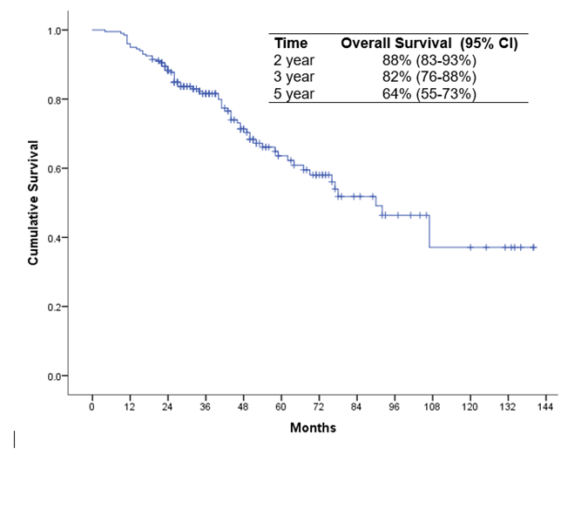
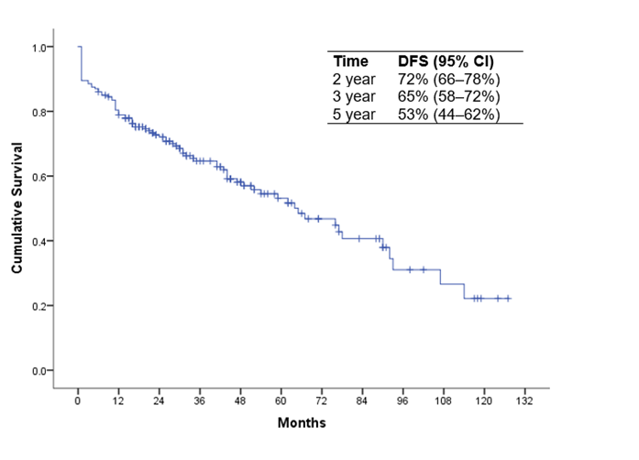
Overall survival
Disease free survival
DFS =72% (2 years)
Sun Myint et al. BJR. 2017; 90: 108020170175.

Slide 33
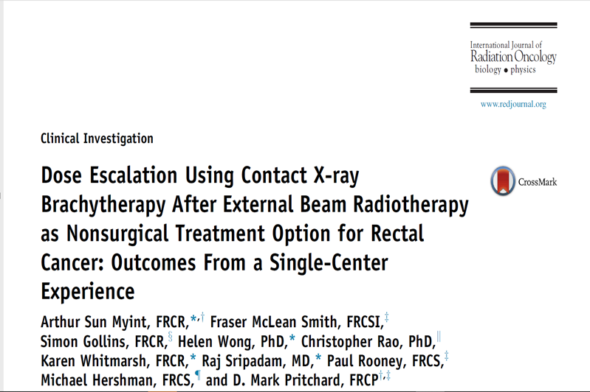
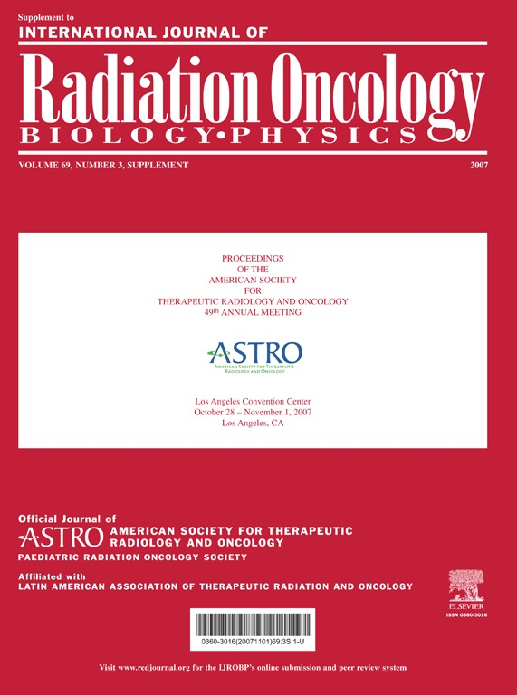
2003-2012
All pts had EBCRT + CXB (4-6 weeks)
n= 83 EBCRT + CXB
Median age 72 years 70% men
cT2= 34% cT3= 66% cN1= 54.2%
cCR=64% (53/83) Pts who had EBCRT are- advanced tumour/>3cm
Local regrowth= 13% (7/53)
Salvage surgery= 86% (6/7) non metastatic local regrowth
Sun Myint et.al. Int J Rad Oncol Bio Physics 2018;100(3): 565-573

Slide 34
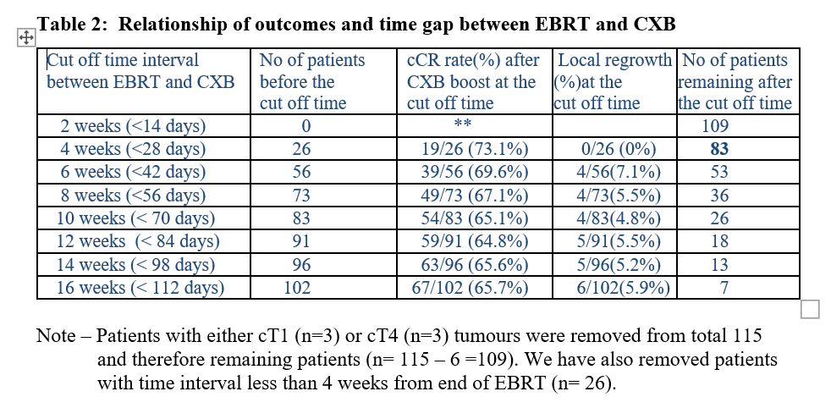
Does the ‘Gap between EBCRT and CXB’ influence outcomes?
Unpublished data ;2017

Slide 35
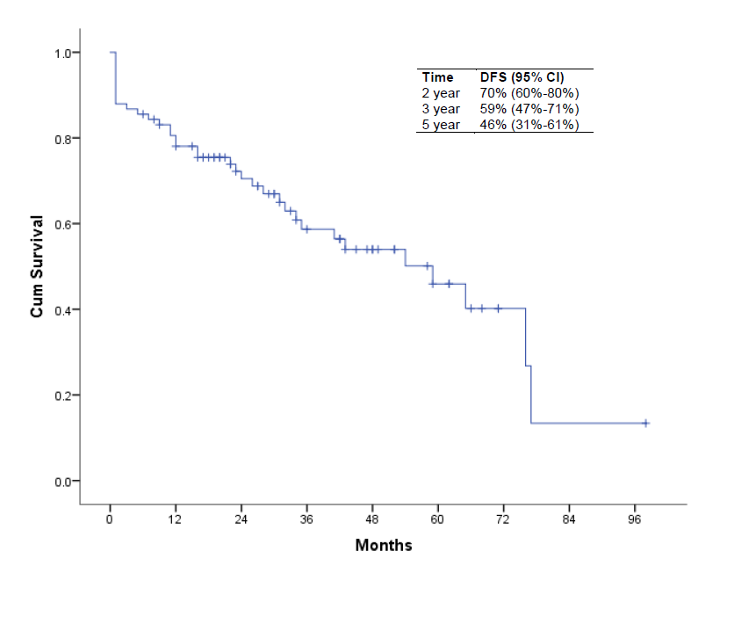
Disease Free survival
DFS=70% (2 years)
Sun Myint et.al. Int J Rad Oncol Bio Physics 2018;100(3): 565-573

Slide 36

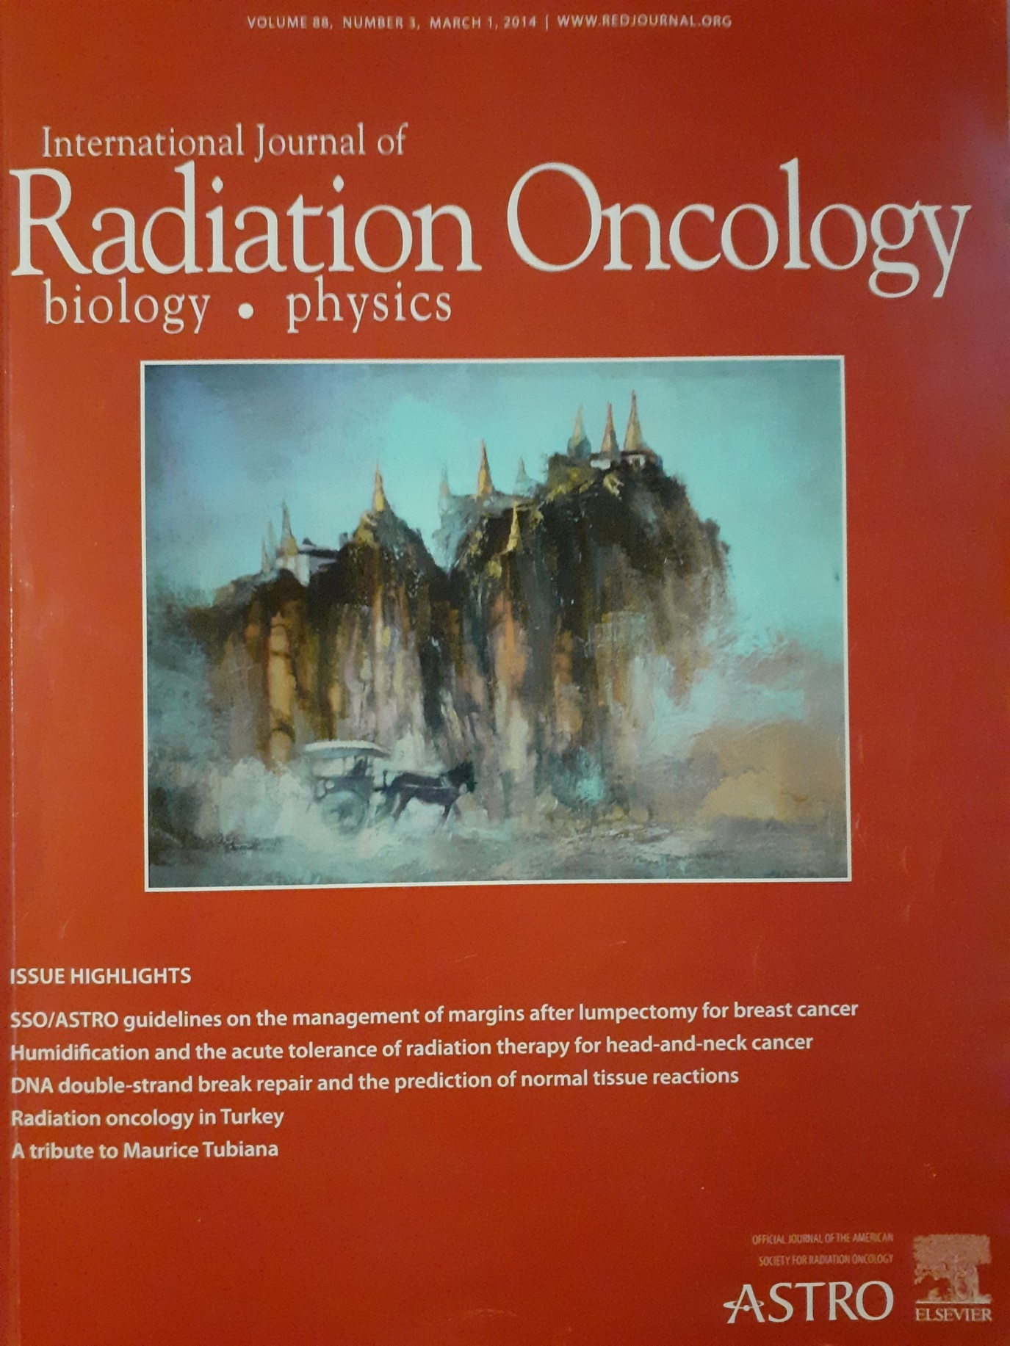
‘The pilgrim’ oil on canvas 60 X43 cm by Sun Myint (1976)
Int J Rad Oncol Bio & Physics March 2014; vol 88: No3

Slide 37
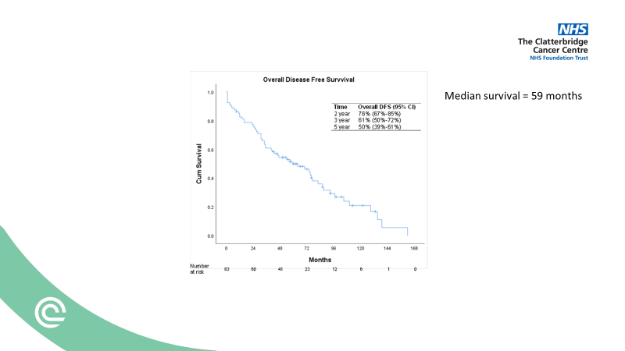
Overall Disease Free Survival
Median DFS = 59 months
Median overall survival=83 months
Median FU 5.8 years (2-11)
Local recurrence = 10/83 ( 12%)
Distant recurrence= 8/83 (9.6%)
Stoma free = 62/83 (75%)
Alive CR = 26/29 (89%)
Dead CR = 35/54 (65%)
Sun Myint et al. In preparation for Int J of Rad Oncol Bio & Physics. 2021

Slide 38
Why do we need Papillon boost? There is always a residual tumour even for very early rectal cancer following either EBCRT or SCRT which needs eradication. This is to reduce the chance of local regrowth as there is approx. 25% local regrowth after apparent clinical complete response.

Slide 39
277 centre in 44 countries
N= 673/ 2572 (26.2%) had EBCRT and surgery
pCR =10.2% ( 67/649)
[Residual approx 90% in advanced stage tumours]
MRI over staging = 34% ( 148/429)
MRI under staging= 13% ( 55/429)
Colorectal Disease 2018; 20 (Suppl.6):58-68

Slide 40
N = 55 patients with cT1/cT2/cT3 N0 Had EBCRT reassess at 6 weeks
n = 47 /55 had TEMS at 8-10 weeks
pCR = 21/47 (45%)[Residual tumour 55% in early tumour]
BJS 2015; 102: 853–860

Slide 41
N = 62 cT1 cT2 cN0 SCRT reassess at 6 weeks TEMS at 8-10 weeks
R0 = 60/62 (97%)
pCR = 20/62 ( 32%)[Residual tumour 68%in early tumour]
BJS 2016; 103: 1069–1075

Slide 42
Comparative outcomes
Study | n | treatment | cCR | regrowth | Organ preservation
1. Habr Gama | 183 | EBCRT + chemo 54Gy/30/42 | 49% | 31% | 28%
2. Appelt | 55 | EBCRT +HDR 60Gy/30/42 + 5Gy | 73% | 26% | 55%
3. Renehan | 129 | EBCRT 45Gy/25/35 | NA | 38% | NA
4. Sun Myint | 200 | EBCRT + CXB 45Gy/25/35+ 90Gy | 72% | 11% | 65%
1.Habr Gama et al. Int J Rad Oncol Bio Phys 2014; 88(4):822- 828
2. Appelt et al. Lancet Oncology 2015;16(8):919- 927
3. Renehan et al. Lancet Oncology 2015; 17(2):174-183
4. Sun Myint et al. Br J Radiology 2017; 90:2017017

Slide 43
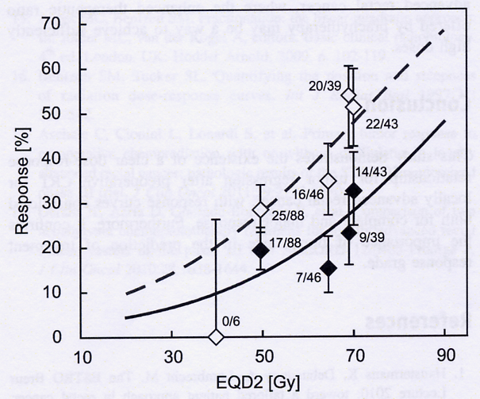
Why Papillon works ?
Contact X-ray Brachytherapy
Dose escalation with Papillon increases the tumour response
Standard dose
DOSE
A Appelt et al Int J Rad Oncol Bio Physics 2013 ; 85: 74
/2009
30/05/2009
Notes:
43

Slide 44
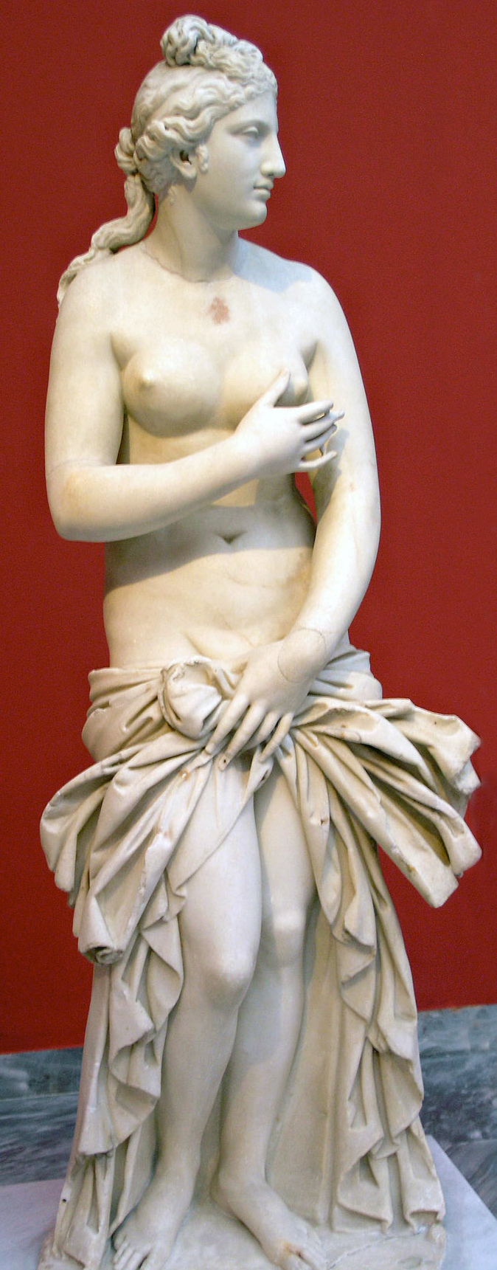
APHRODITE Trial
Small UK Phase 2 randomised trial n=104
Patients not suitable for radical surgery (PS 0-2)
cT1-cT3 cN1 <4cm rectal cancer
EBCRT
50.4Gy
EBCRT
62 Gy
End point cCR at 6 months 35% vs 55%

Slide 45
We need evidence

Slide 46
OPERA phase 3 randomised trial (2015-2020)
Mid /Low
rectal cancer
EBCRT
+EBRT boost
EBCRT
+Papillon boost
Inclusion
cT2/cT3a/cT3b
No /N1
Size <5cm
End point
Organ preservation(3yrs)
Arm A
Arm B
Assessment at 14,20,24 wks
cCR ‘Watch & Wait’
TEMS for PR
TME for NR
Hypothesis -20% difference in organ preservation between Arm A and Arm B
clinical trials.gov (NCT 02505750)

Slide 47
OPERA (NCT02505750) (Organ Preservation for Early Rectal Adenocarcinoma)
2015 -2020
n=142 of which 123 were evaluable (completed 24 week review)
Arm A=71 Arm B=71
35%(43/123) needed surgery
TME=27 ( APR=8[30%] + AR = 19[70%])
Local excision= 16[37%] patients
Conclusion : 78% organ preservation was achieved without compromising their chance of cure. All those who needed surgery can be salvaged
Sun Myint et al ASCO, J Clin Oncol 39, 2021 (suppl 3; abstr 12)

Slide 48

OPERA –Preliminary results
Sun Myint et al. JCO 2021; 39(3): Sup 12

Slide 49

OPERA – Preliminary results
Sun Myint et al. JCO 2021; 39(3): Sup 12

Slide 50

CONTEM-1 The role of CXB (post local excision)
Local relapse rate was 8% and distant metastases 9%. Organ preservation was achieved in 95%.
6 year local recurrence free 91% overall survival 81% Cancer specific survival was 97%.
Dhadda et al. Radio & Oncology 2021; 162:195-201

Slide 51

Commissioning of Contact Xray Brachytherapy(Papillon)
Prepared by NHS England Specialised Services Clinical Reference Group (CRG) for Radiotherapy.
NHS England has carefully reviewed the evidence to treat early rectal cancer with
low-energy contact x-ray therapy. We have concluded that there is insufficient
evidence to consider making the treatment available
NHS England. 2018. Evidence review: 1715

Slide 52

21/19 NIHR Commissioned call for early rectal cancer when surgery is not planned. 2021.

Slide 53
EXPRESS Time Line
EXcision versus Papillion as a REctal Saving Strategy
NHSE Commissioning through evaluation (CtE) dropped Jan 2021
N​IHR research commissioned call (21/19)for HTA Funding
Stage 1 submission 28th July 2021
Stage 2 Funding September 2021
Trial will start September 2022
Trial stop September 2026
Trial end September 2028
21/19 NIHR Commissioned call for early rectal cancer when surgery is not planned. 2021.

Slide 54
N=186 cT2 cT3 size <4cm (location <8cm) who responded well to neoadjuvant EBCRT (CAP 50) with residual cancer <2cm
N= 148/186 ( 80%) good responders were randomised to TME vs local excision
145 patients analysed TME n=71 vs L.E n=74
Organ preservation rate 28/74 (38%)
INTERPRETATION:
No evidence of difference in oncological outcomes between local excision and total mesorectal excision. Local excision can be proposed in selected patients having a small T2T3 low rectal cancer with a good clinical response after chemoradiotherapy.
Lancet. 2017 Jul 29;390(10093):469-479
Lancet. 2020 Feb 7 ; 5:465-474

Slide 55

Eligible- Post EBCRT or SCRT-<3cm cT1/cT2/cN0
Unfit for surgery
Unwilling to has surgery
Randomisation 2:1 (in favour active arm)
CXB
TEMS
ARM 1
CXB immediate
n= 122
ARM 2
CXB delay
n=61
ARM 3
TEMS immediate
n=122
ARM 4
TEMS delayed
n=61
CXB for progression
TEMS for progression
Failure
Recurrence
Surgery
Mets
Death
Assessment every 3 months DRE. Endoscopy and MRI/CT until event
Primary end point- Failure free survival at 2 years

Slide 56

Patient referrals for Papillon
After initial resistance patients’ voices are now being heard
220
Courtesy data from Dr Helen Wong (2018)

Slide 57


Pattern of referrals for Papillon (2002-2016)
From around the UK
Australia & New Zealand
Europe
USA
India
Myanmar
NATCANSAT 2016 data

Slide 58


Papillon facilities in the UK
Clatterbridge 1993
Hull 2011
Guildford 2014
Nottingham 2014
Hull Papillon team started 2011
89 years
Awaiting decision from NHS England for the specialist commissioners (2018)

Slide 59

GMC guidance on decision making and consent
Consent – give information to patient
Options for treatment must be discuss with the language and terminology that patient can understand
Treat patient as equal partners- consider what the patient wants
Shared decision making and not forcing the treatment which you think is right for the patient
Comes into effect 9thNov 2020
Decision making and consent GMC guidance 2020 gmc-uk.org

Slide 60

Do patients have a choice?
Papillonpatientsupport.com
Arthur Sun Myint. BMJ 2019;366:15363

Slide 61



Patients’ partnership
Patients have driven our project,
from its inception, 28 years ago…..
Advocate of patient’s choice
Living beyond cancer
We must not just aim to save lives of our patients but must also try to improve their QOL post treatment
Mark Davies
Mark Davies. Saving my Arse. 2008, 2011

Slide 62




We must learn to think outside the box
The Future
Training
Governance
Guidelines
Protocols
Change in stage (NBCSP)
Advances in Science
Advances in Technology
New Innovations
New Concepts
Must change our mind set
Patient’s choice
TEMS
Papillon
Minimally invasive - Less Harm
The Standard of Care

Slide 63


H2020
CAST
“Active Monitoring of Cancer As An Alternative To Surgery” (CAST) MSCA-ITN-857894
Our Papillon research project has received funding from the European Union's Horizon 2020 research and innovation programme under the Marie Sklodowska-Curie grant agreement
2 students to do PhD at the University of Liverpool
and training at Clatterbridge from May 2021 -2024
Dr Ngu Wah Than and Dr Margarita Karageorgou

Slide 64


Multidisciplinary management of early rectal cancer
Chaired by
Prof Neil Mortensen
President of RCS
Prof Bill Heald
Prof Jean Pierre Gerard
Prof Chris Cunningham
Mr Simon Bach
Prof Simon Gollins
Mr Chris Rao
Prof Arthur Sun Myint
Recording: https://zoom.us/rec/share/W_P7jAzaP7ikW-Pld57Ir14lpDDVeEPhM5k-JmUyAr6Aj-Szoq2ej292xnLbZB0p.Q29dRu1A-jdGSU9g
The Royal Society of Medicine Surgical Meeting 1st September 2021

Slide 65

My presentation at the RSM meeting September 2021
Proceedings of Multidisciplinary management of early rectal cancer. RSM 2021

Slide 66




Our Vision
In collaboration with our patients and colleagues we hope that our project ‘Papillon for rectal cancer’ will “Lead the way rectal cancer is treated globally”
The UK Papillon team 25 years
winners
Winner of BMJ awards ‘Cancer team of the Year 2018 ’

Slide 67


ESTRO ‘Lifetime achievement award’ August 2021

Slide 68
Take Home message
Please allow patient to choose the treatment option that suites them best. Planned organ preservation if they choose. Patients know what they can accept and cope.
Consider Watch and wait for good responders following EBRT as an option when patients are either not suitable for surgery or refusing surgery
Remember, patient may not want a stoma if they have a choice.

Slide 69


My goal in life
Through my research and work, I hope to establish non surgical treatment
using CXB (Papillon) as the ‘standard of care’ for suitable patients with
rectal cancer who are not keen on a stoma.
We are nearly there !

Slide 70
My Papillon Journey Past, present and the future
H2020 CAST project MSCA-ITN-857894
Thank You
Arthur Sun Myint
Lead Clinician ( Papillon)
Clatterbridge Cancer Centre
Hon Professor University of Liverpool
Research and Innovative Grand Rounds
Clatterbridge Cancer Centre -17th September 2021

